Slide 1
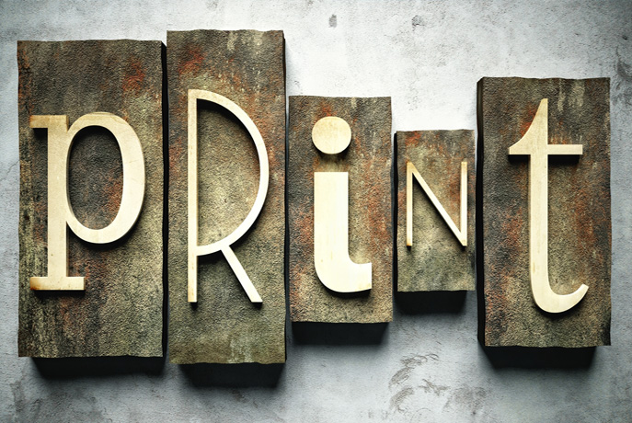
The History of
A few key moments

Slide 2
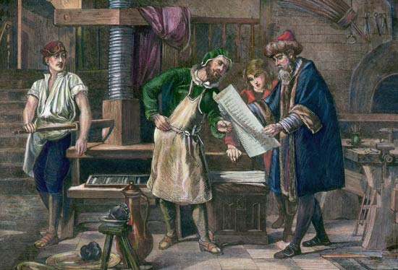
Johannes Gutenberg Invents The Printing Press
using movable type, 1440.

Slide 3
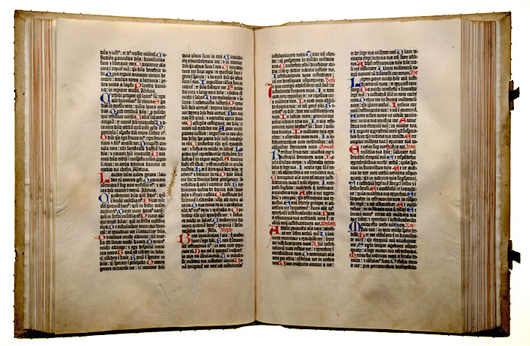
Gutenberg Bible completed, 1455

Slide 4
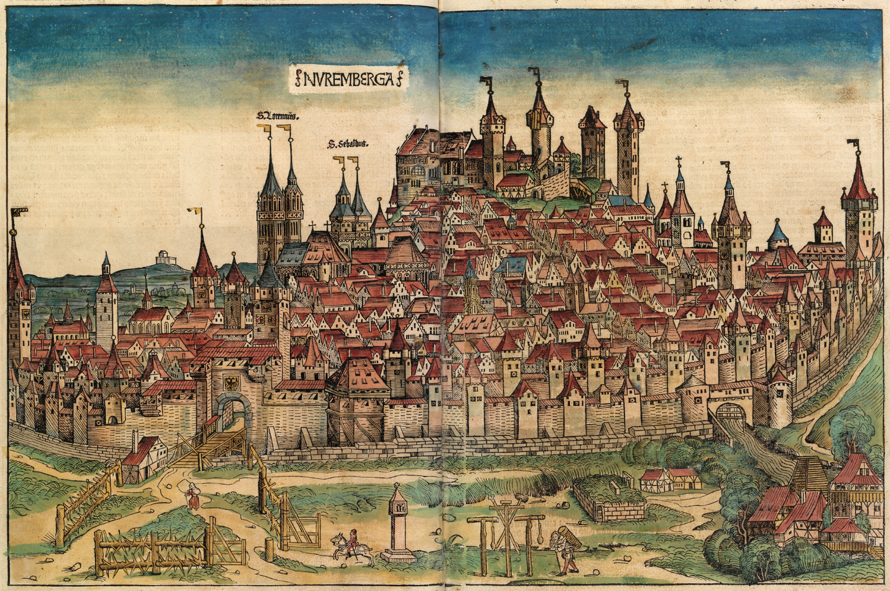
The Paper Mill is created, to keep up with the demand for books.
Due to their noise and
smell, papermills were
required by medieval law
to be erected some
distance from the city
walls.
Nuremberg – 1493
England – 1495
America - 1691

Slide 5
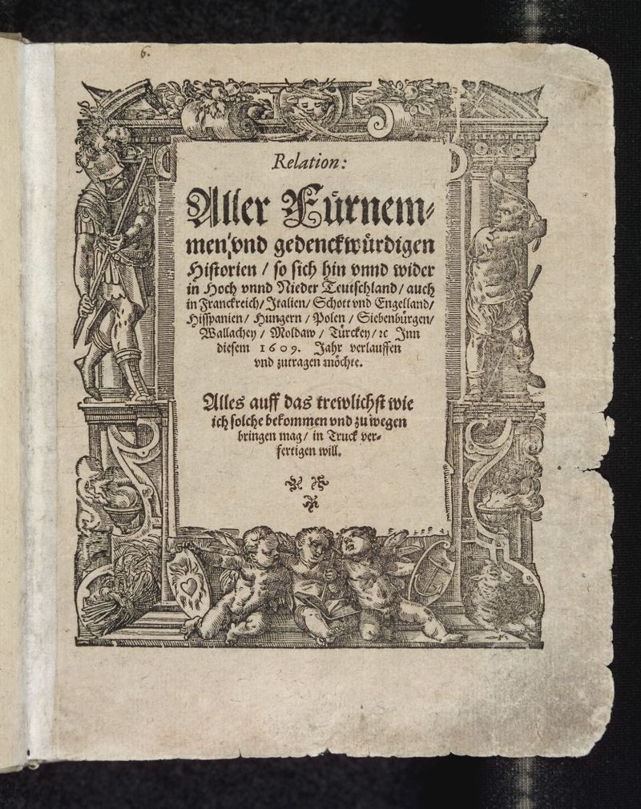
The first daily newspaper is published, Antwerp, Belgium – 1605.
Johann Carolus

Slide 6
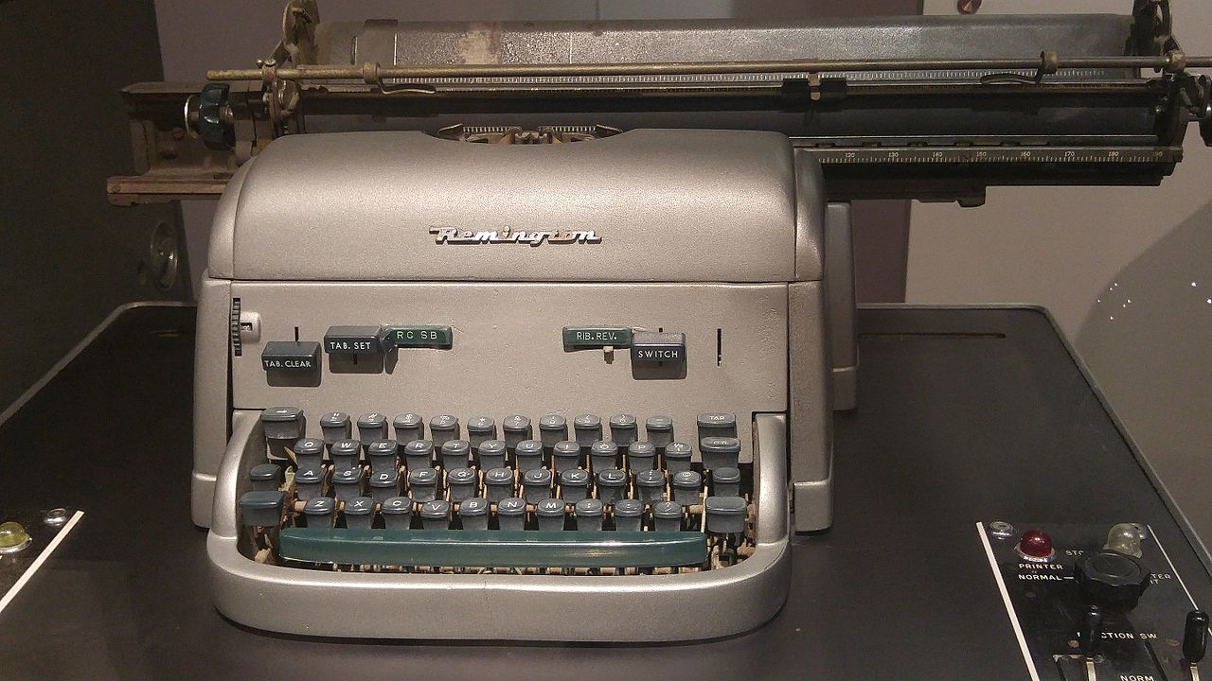
1953 – First high speed printer created for the Univac computer

