Slide 1
Byzantine Military and The Fall of Constantinople
Mr. Fitzpatrick

Slide 2
Objectives
The students will understand how the Byzantine Empire was able to remain strong for over 1000 years.
The students will be able to tell me the reasons for the decline and eventual fall of the Byzantine Empire.

Slide 3
History
The Byzantine Empire lasted from about 306AD until 1453 AD, more than 1000 years.
During its existence, the empire remained one of the most powerful economic, cultural, and military forces in Europe.
Where did their military originate?
What do we know about the Roman military?
So the foundation of the Byzantine army is the Roman army, a Very Strong Foundation.

Slide 4
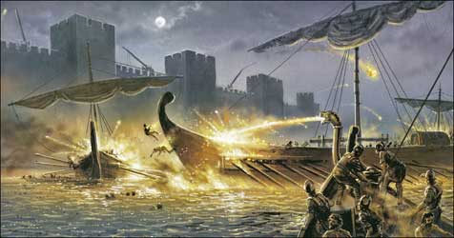
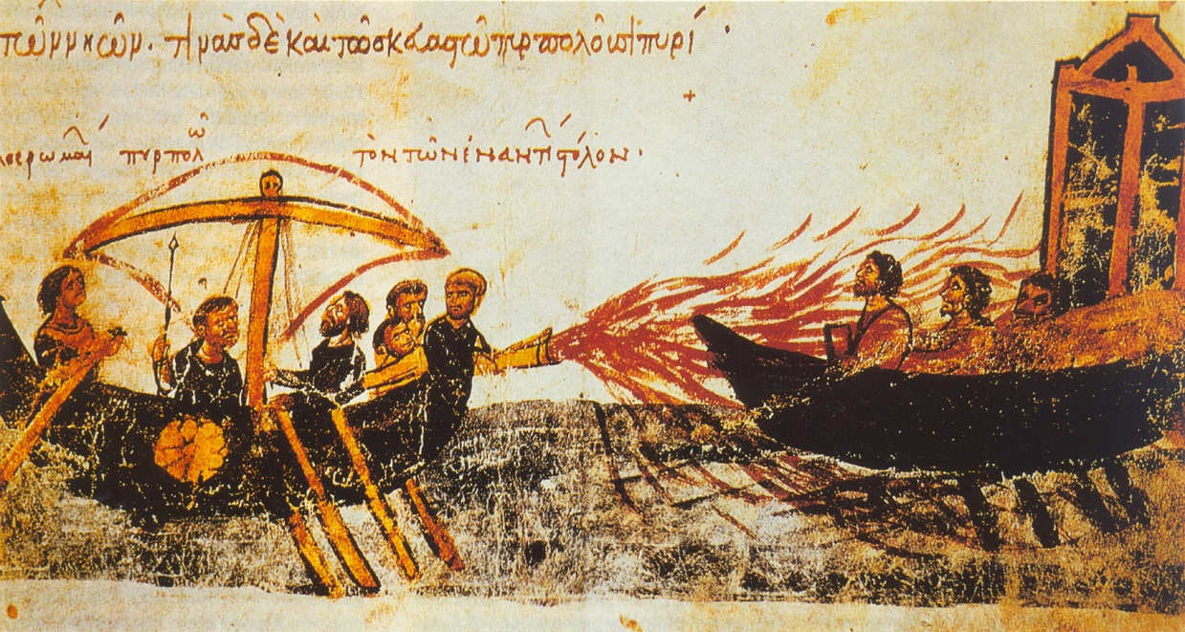
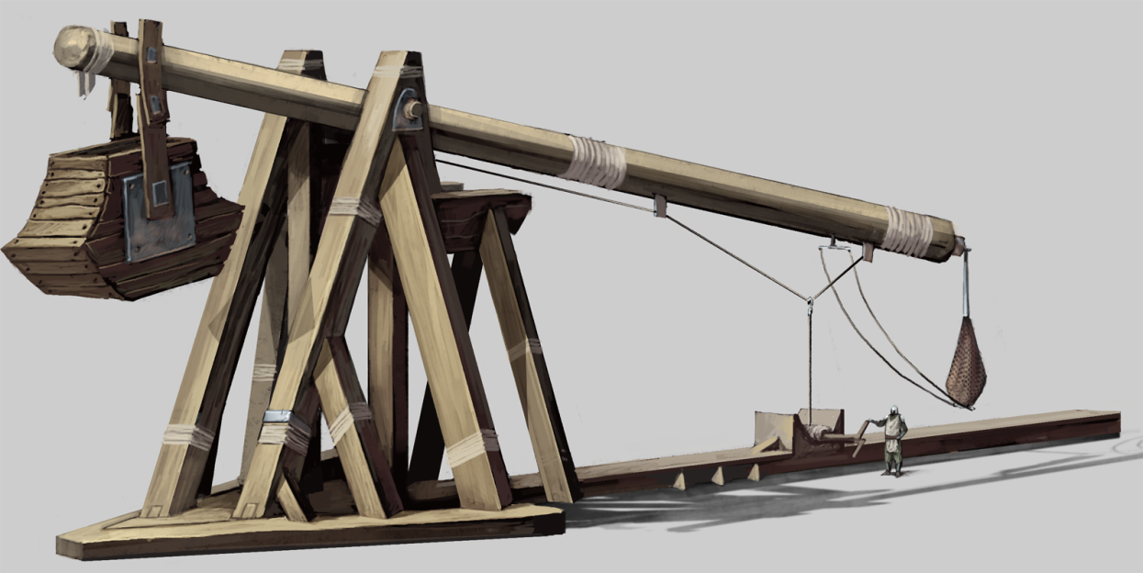
Weaponry
Greek Fire – like an Ancient Flame Thrower, but the fire burned on water (very secretive recipe).
Trebuchet – projected large stones into the air, over walls (pumpkins?).
Grenades – jars full of Greek fire hurled using catapults and trebuchets.

Slide 5
Famous Generals
Belisarius – The most famous Byzantine General. Justinian chose him to begin the reconquest of the Western Roman territories. He also helped put down the Nika Riot.
Narses – Another of Justinian’s generals. Took back Italy from the Ostrogoths. Also aided in the Nika Riot.

Slide 6
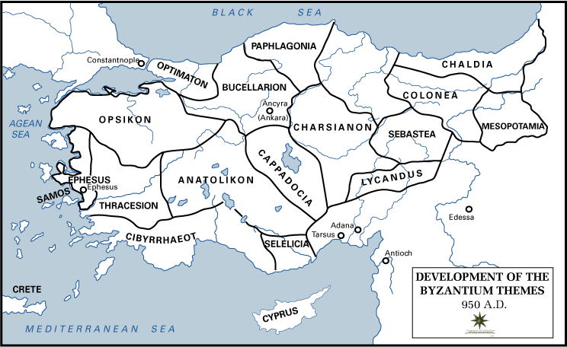
Byzantine Theme System
Localized Armies that could organize quickly.
They were motivated because they were fighting for the own towns, farms, and families.
Do we have something similar to this today?

Slide 7
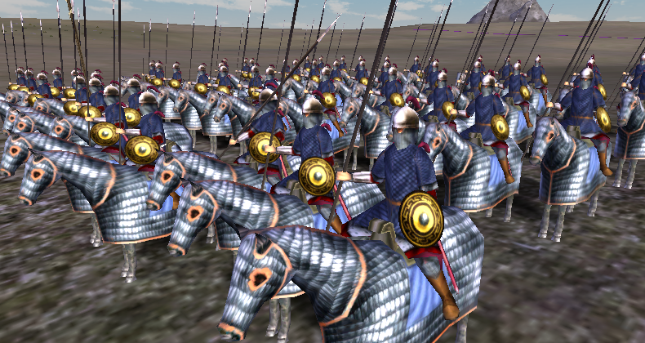
Byzantine Tagmata
This was the professional army.
They turned into the Elite Troops, who were highly paid by the Imperial Government (The Emperor).

Slide 8
The Decline of the Empire From the Inside (Internally)

Slide 9
The Decline of the Empire From the outside (Externally)

Slide 10
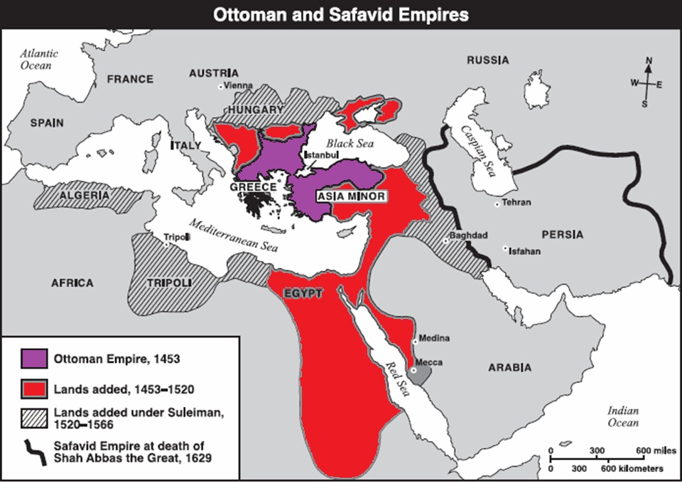
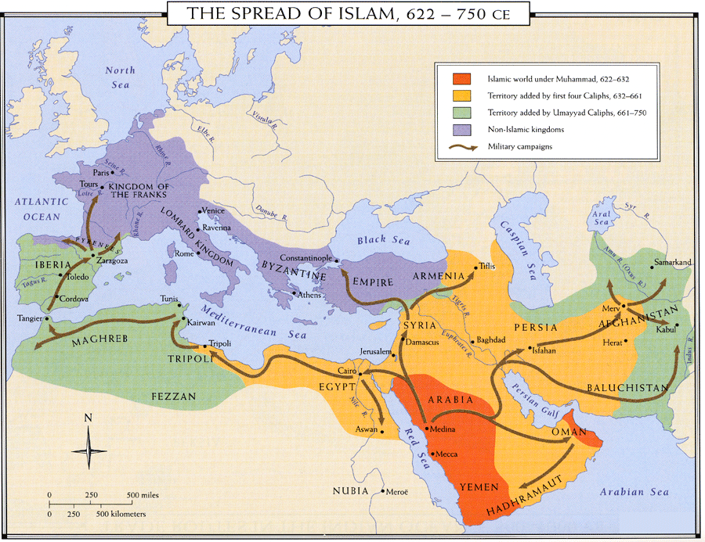
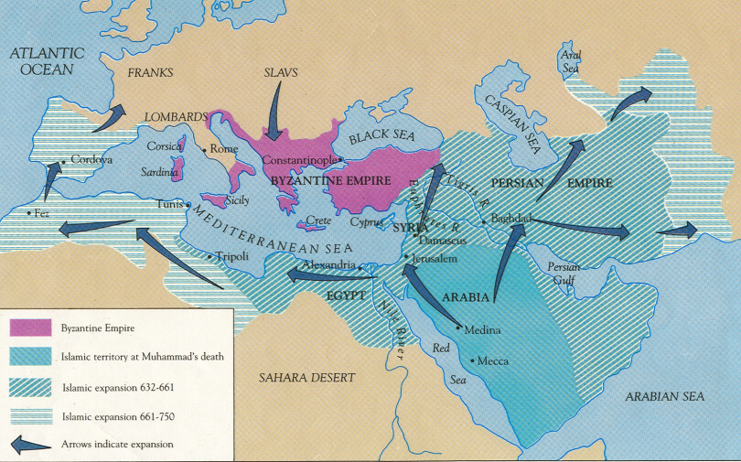
The Fall of Constantinople
Fall of Constantinople
History

