Slide 1
Examine the scene, check out the evidence, then recreate a story as to what you think may have happened here. You will need to fill in the gaps using conjecture. You may type it or write it.
THIS HAS NOTHING TO DO WITH POMPEII. Figure out the dates, then go from there. Work on names.

Slide 2
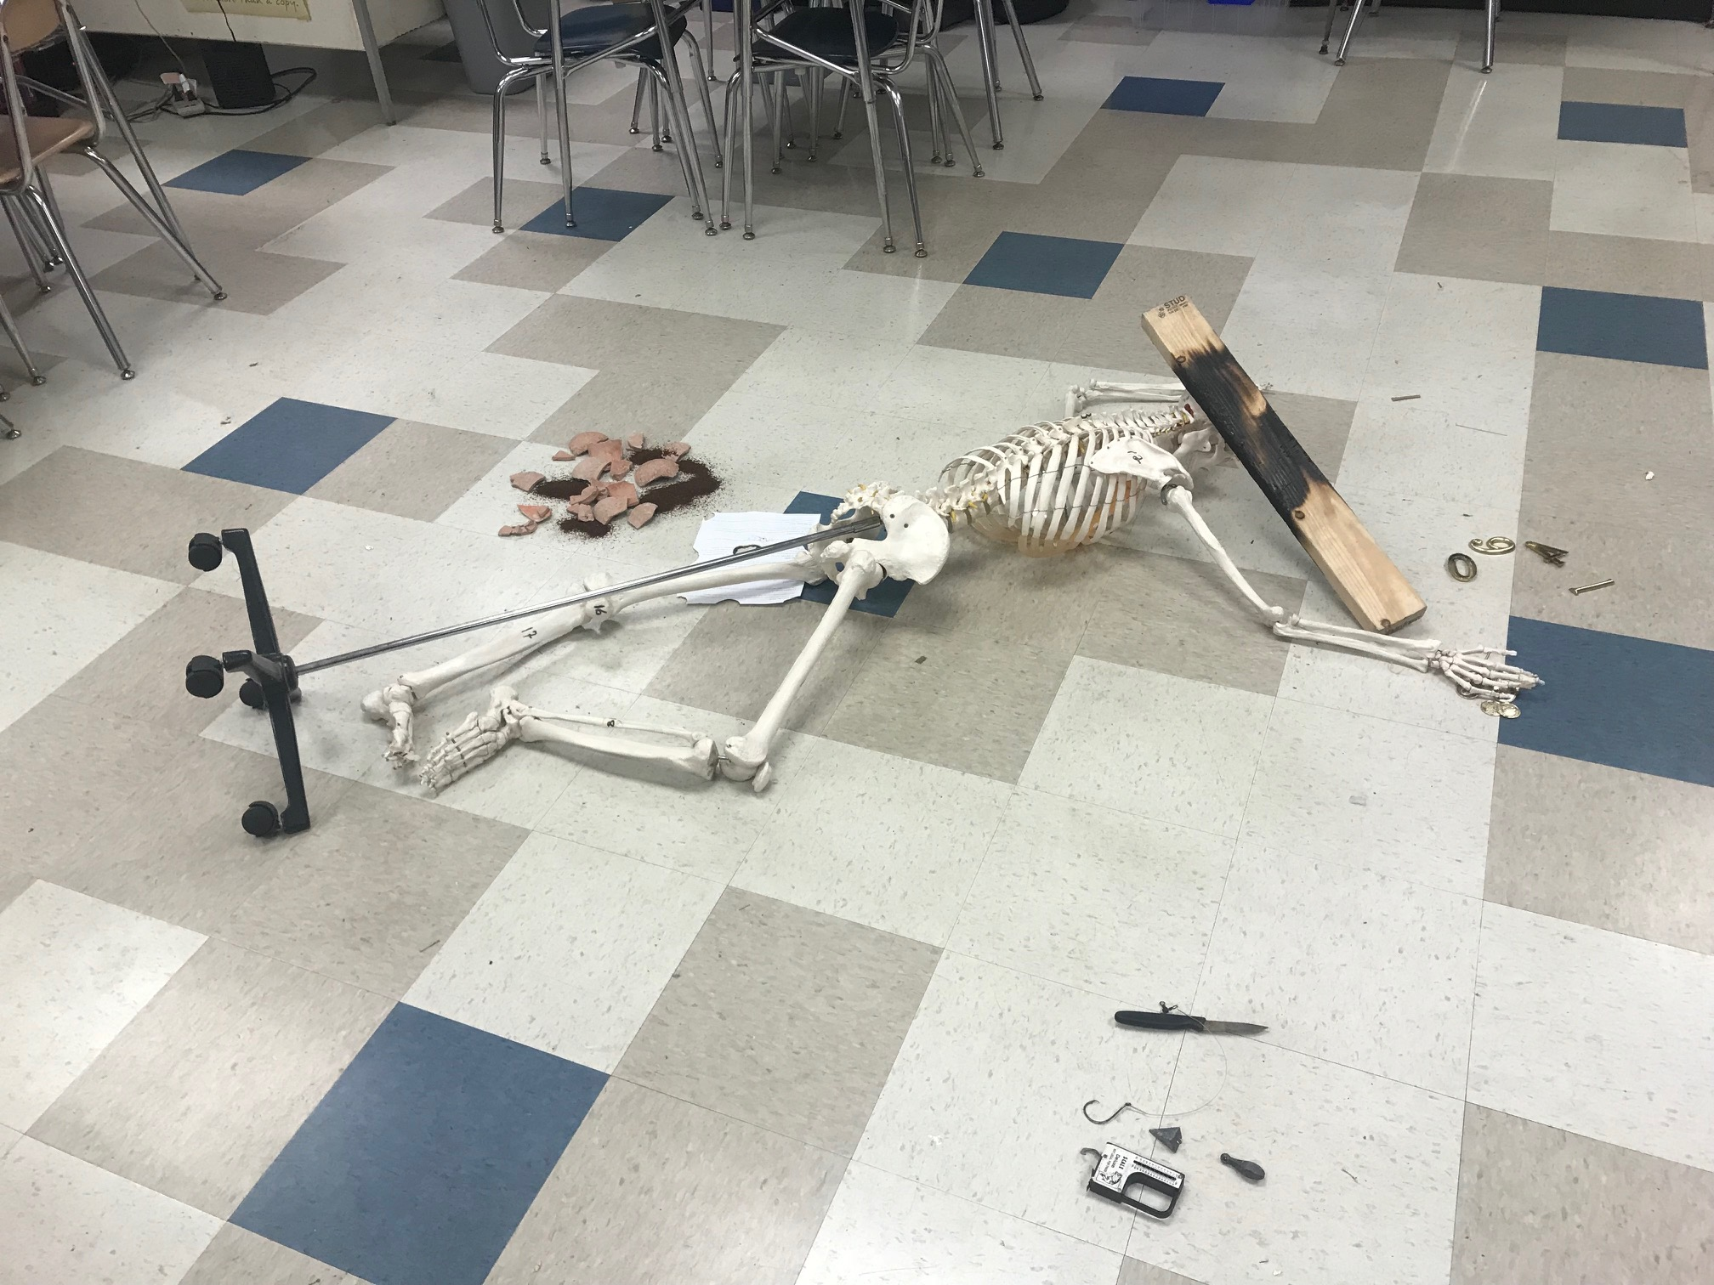

Slide 3
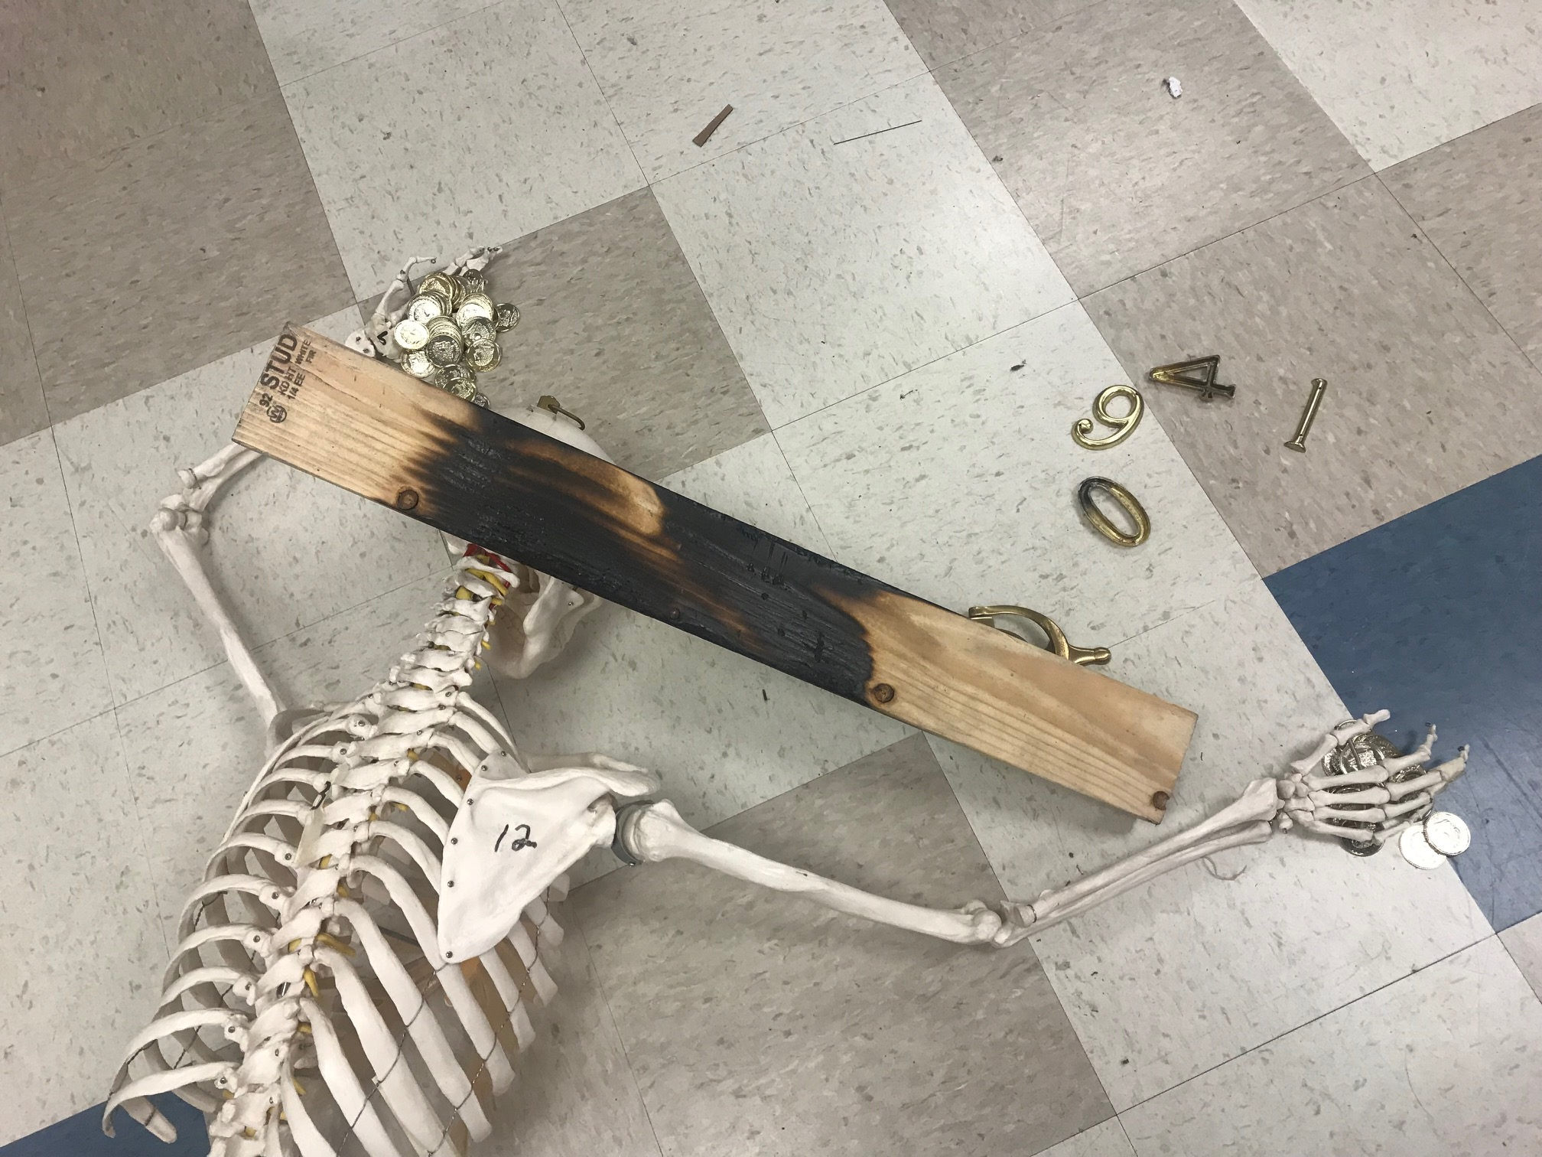

Slide 4
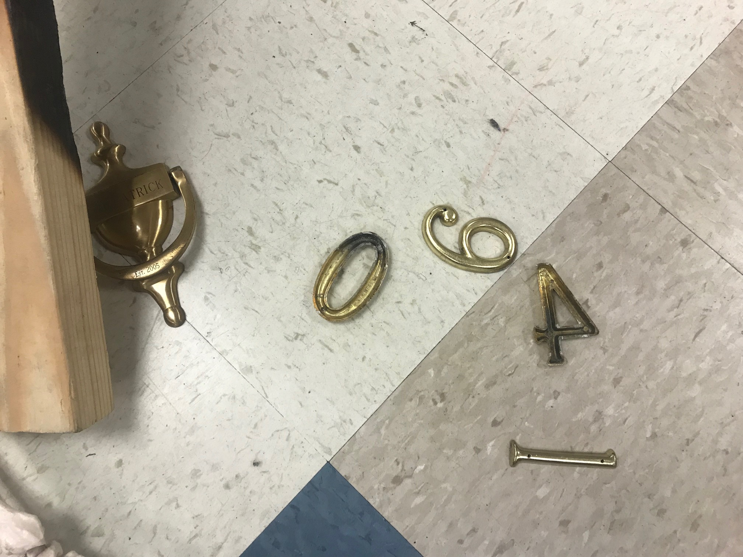

Slide 5
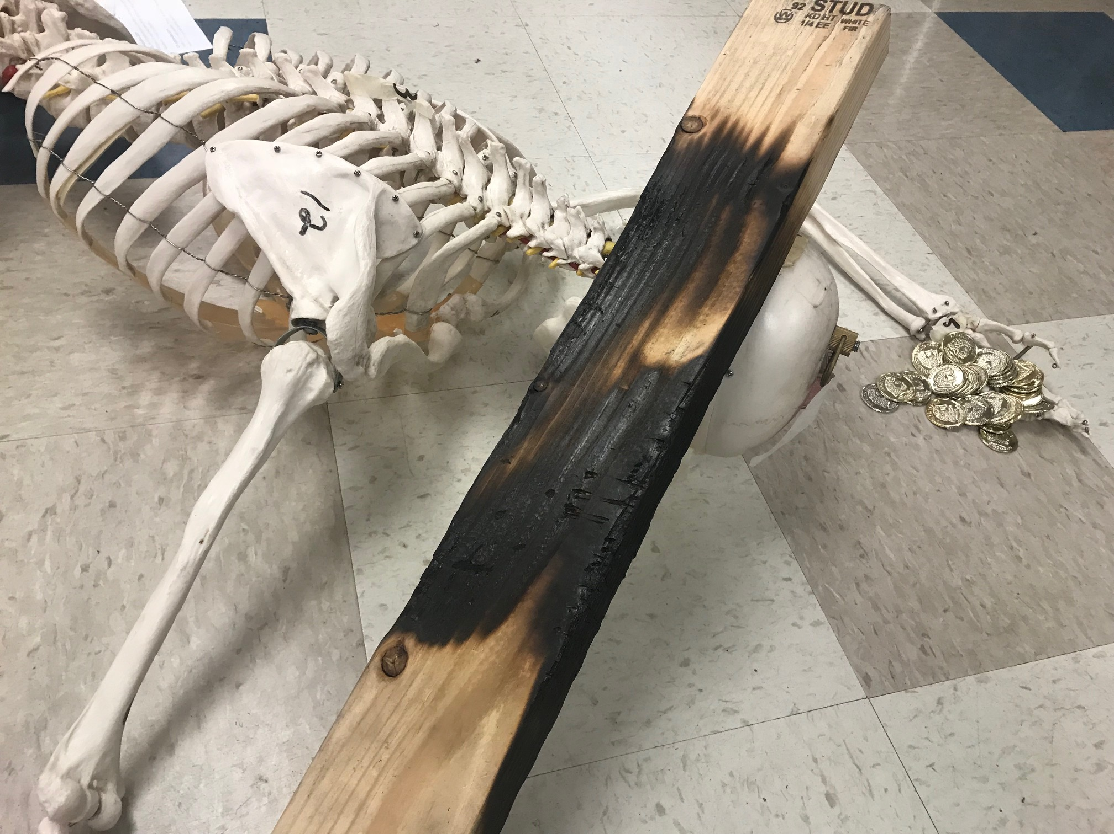

Slide 6
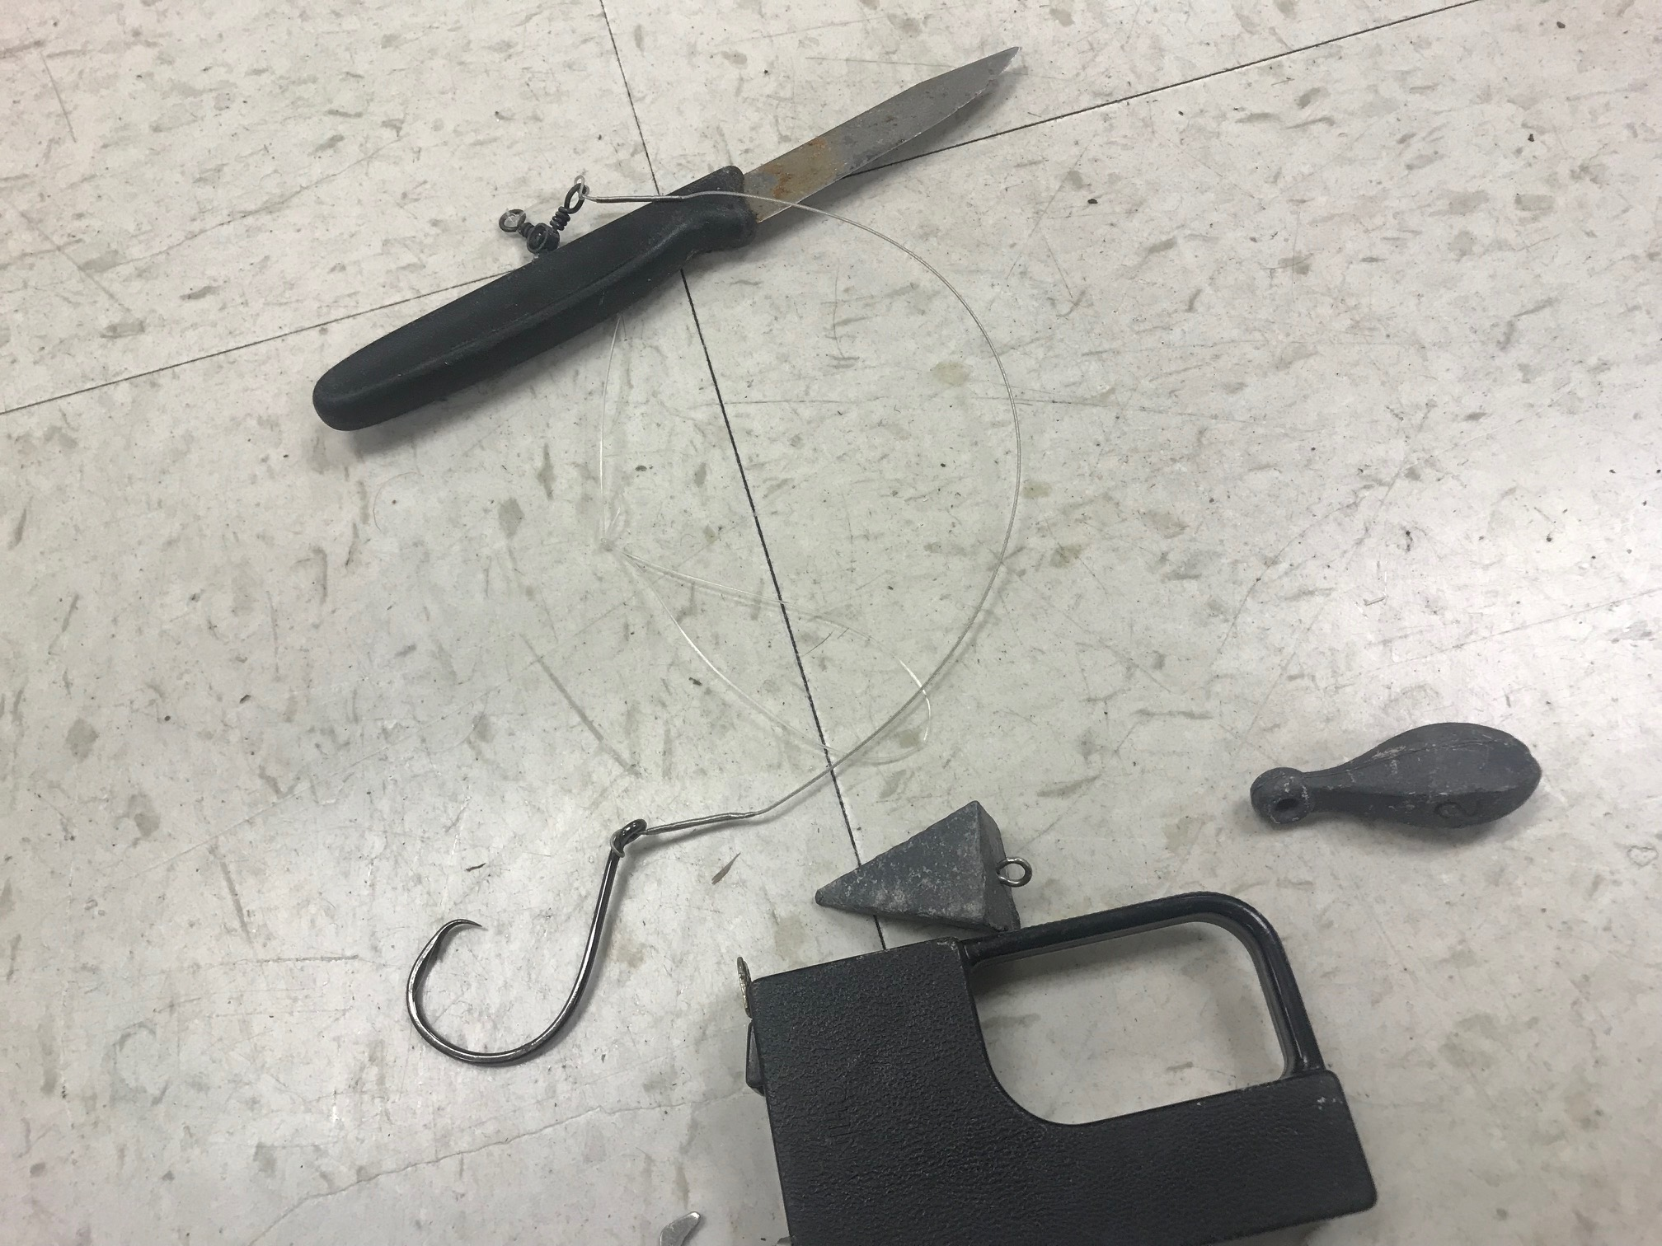

Slide 7
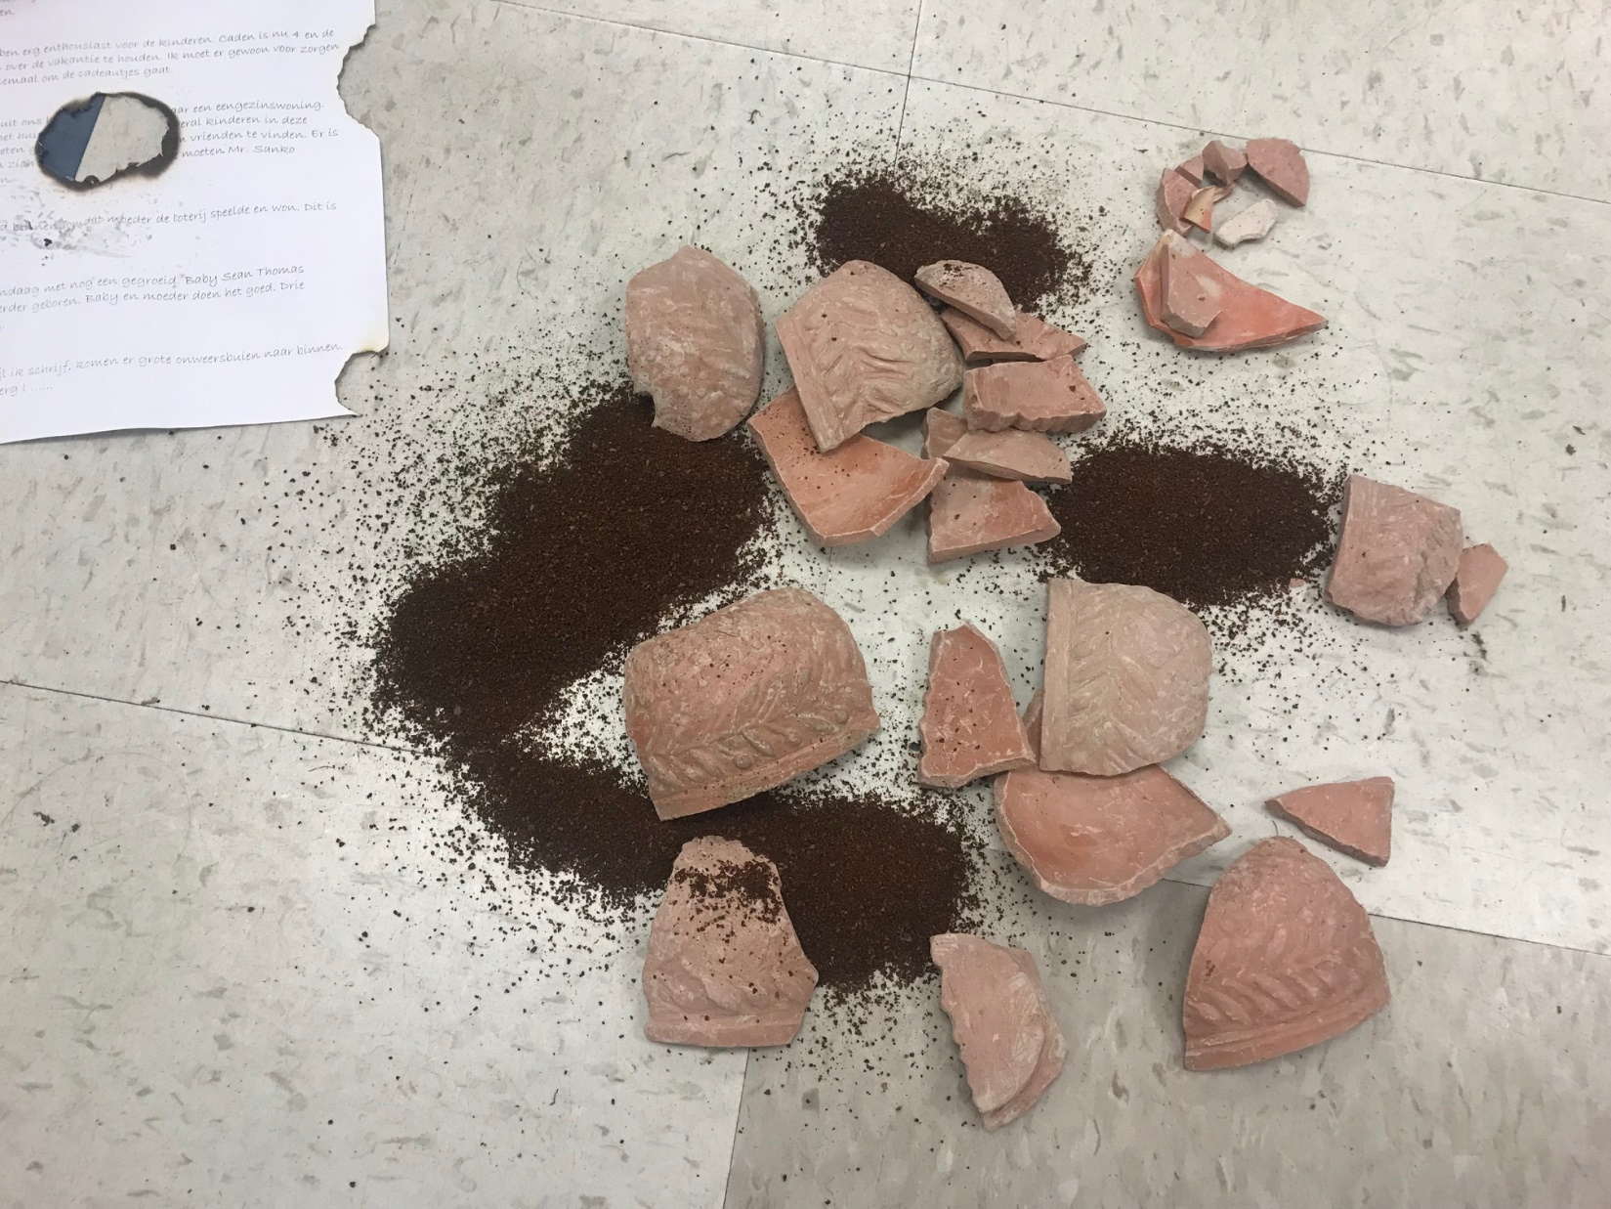

Slide 8
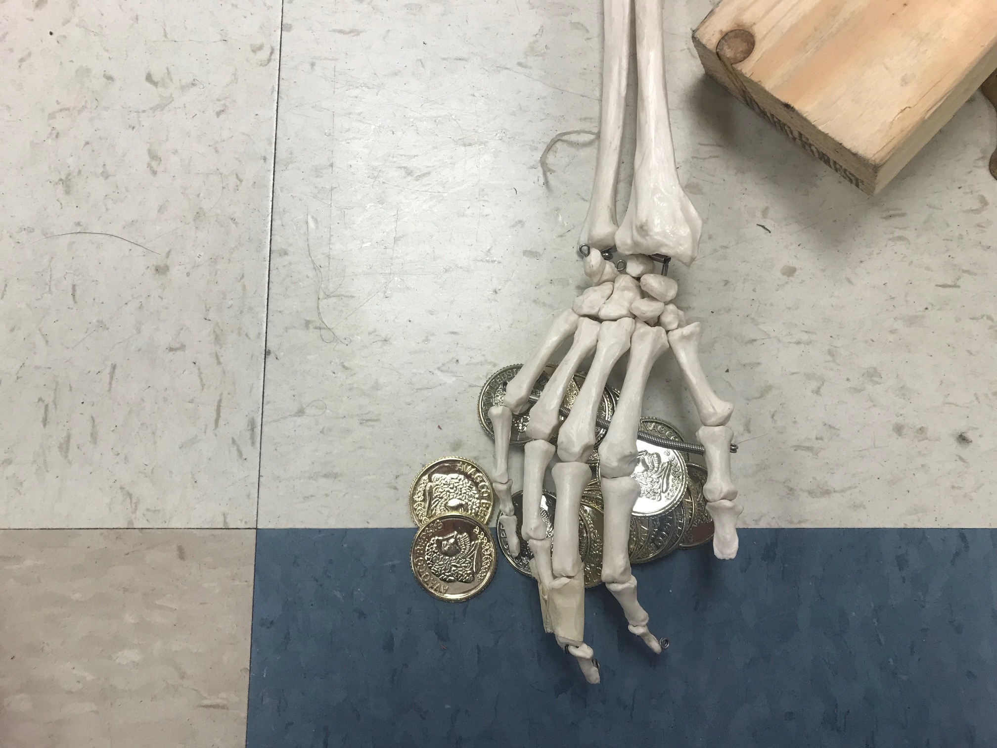

Slide 9
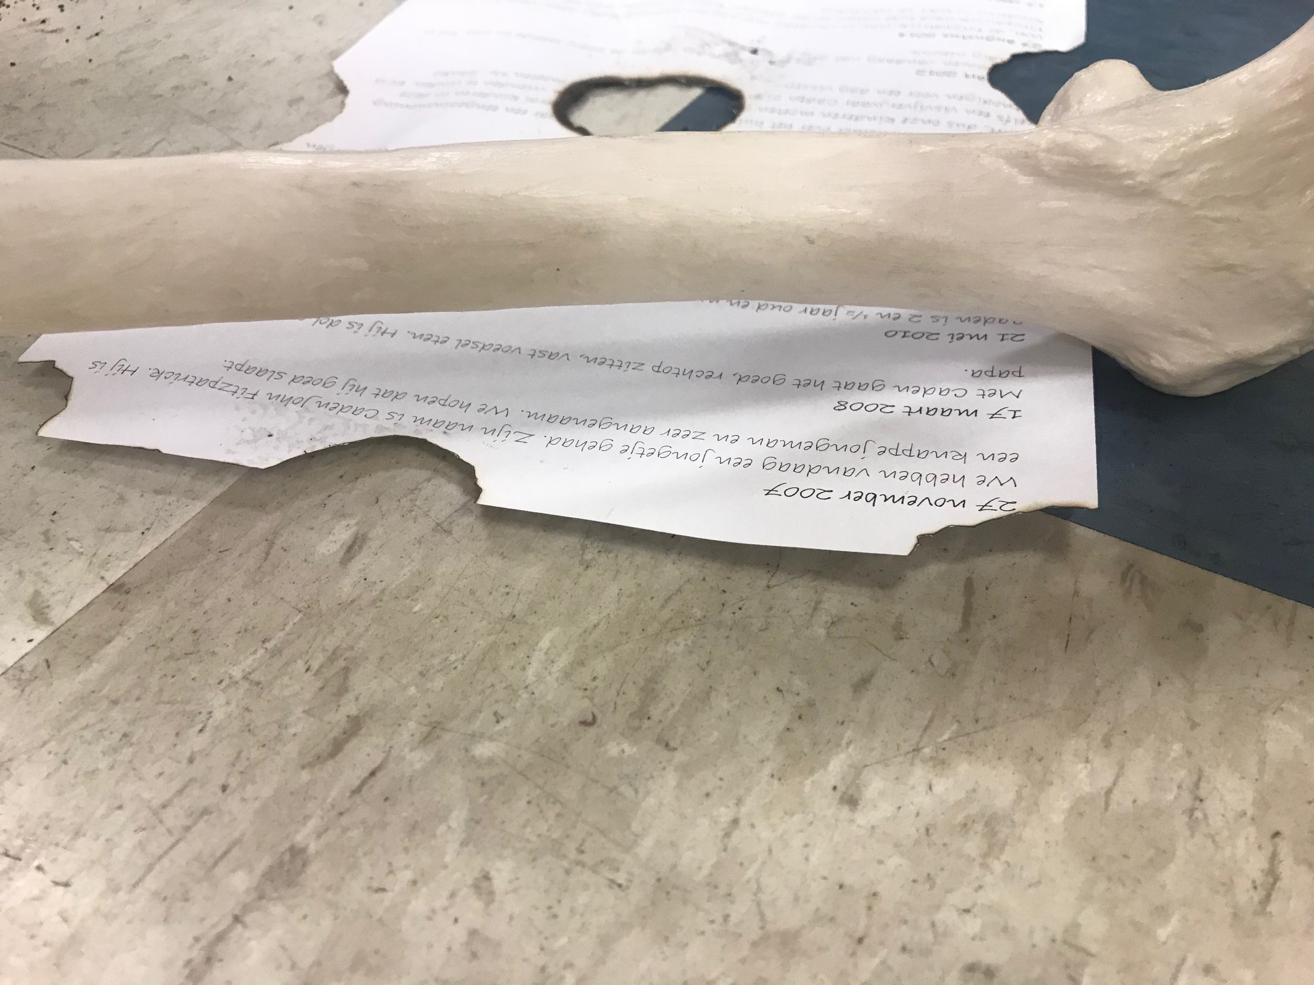
Letter For Periods 4, 5, and 7.

Slide 10
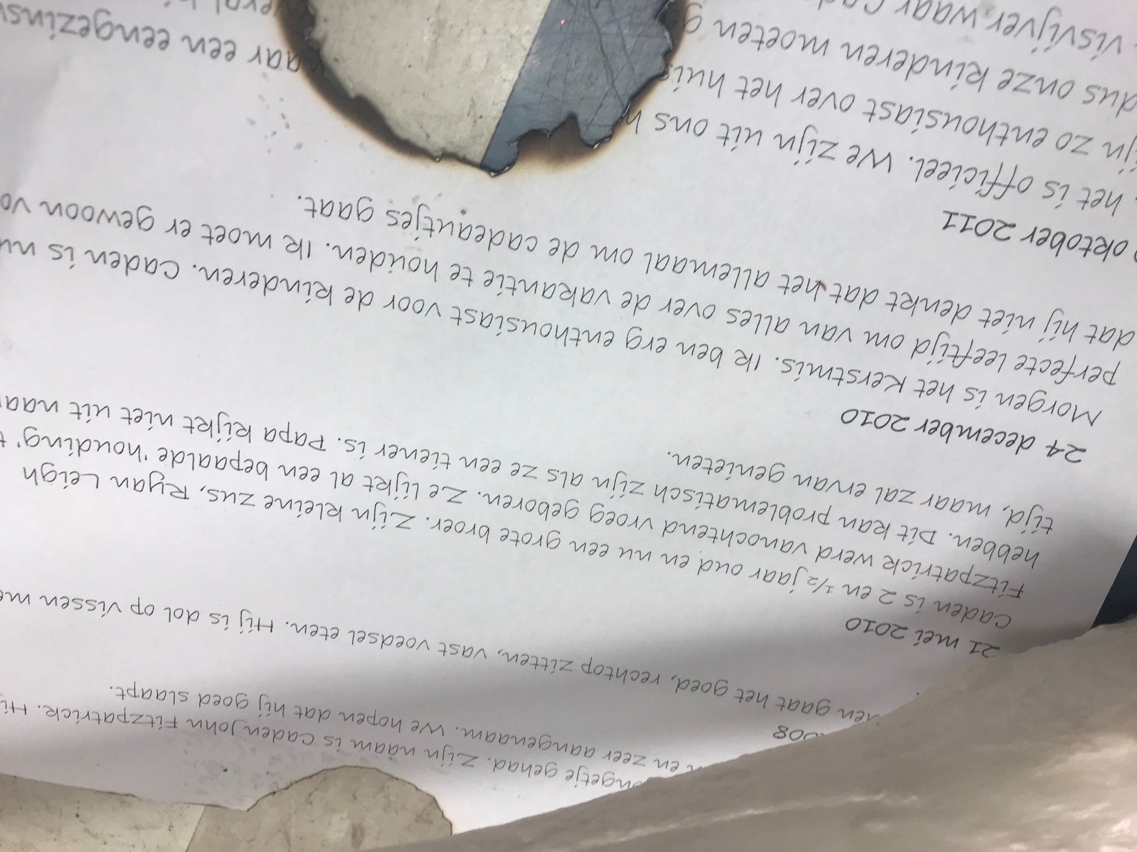
Letter For Periods 4, 5, and 7.

Slide 11
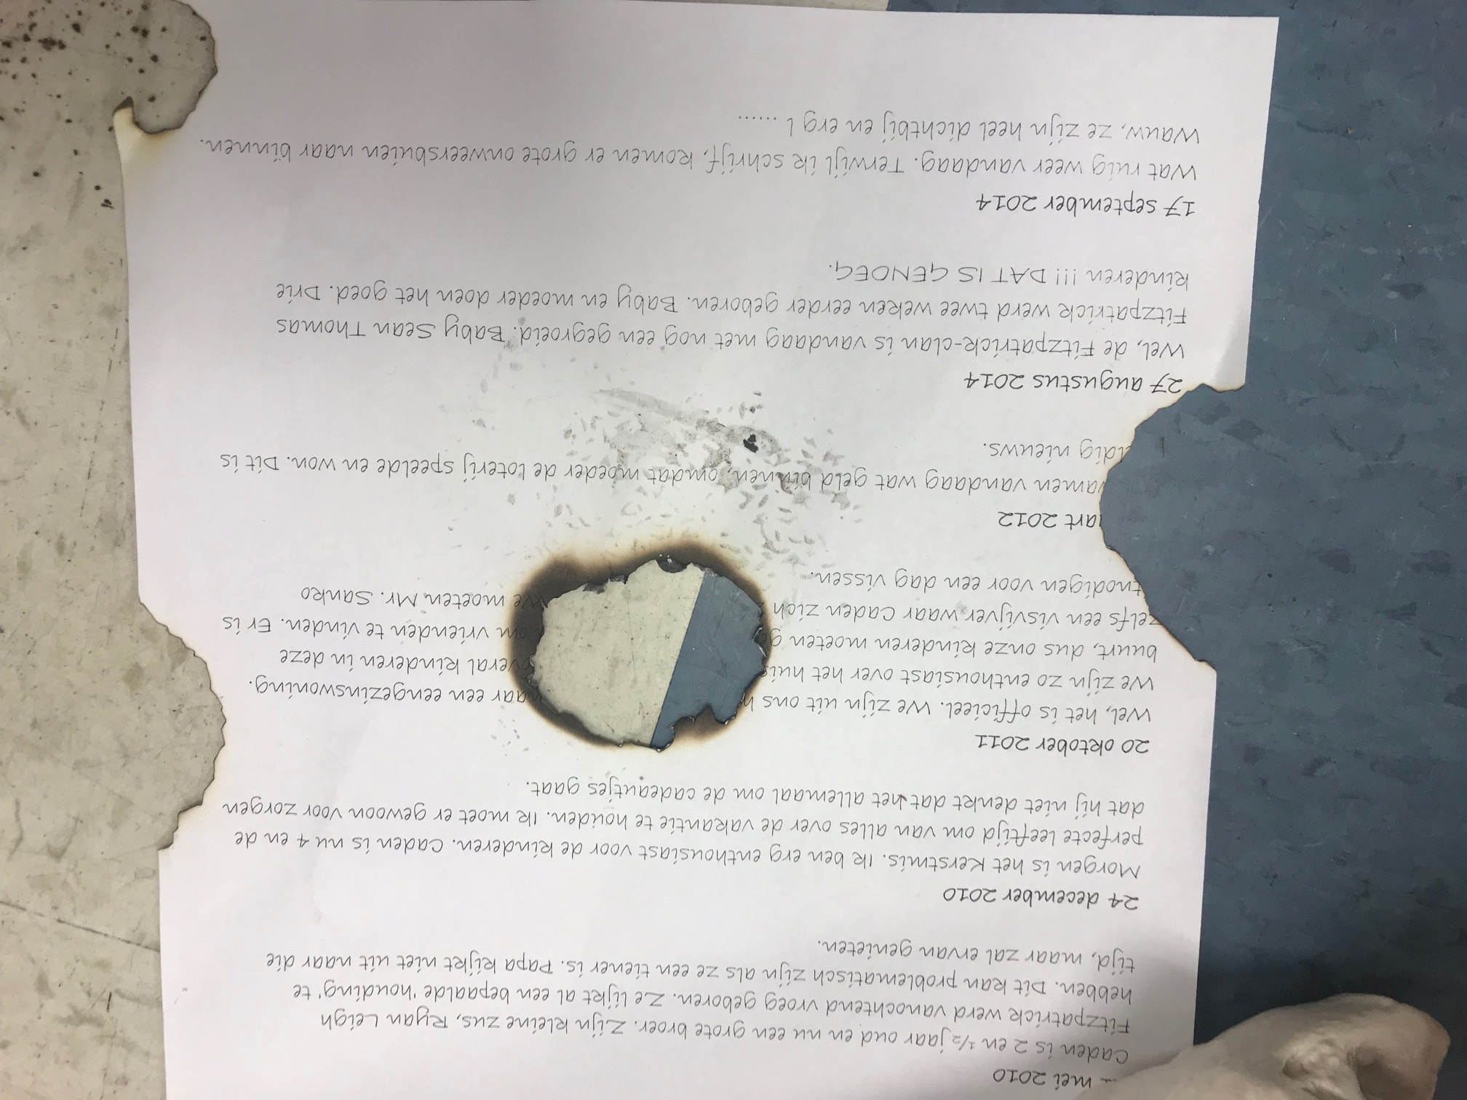
Letter For Periods 4, 5, and 7.

Slide 12
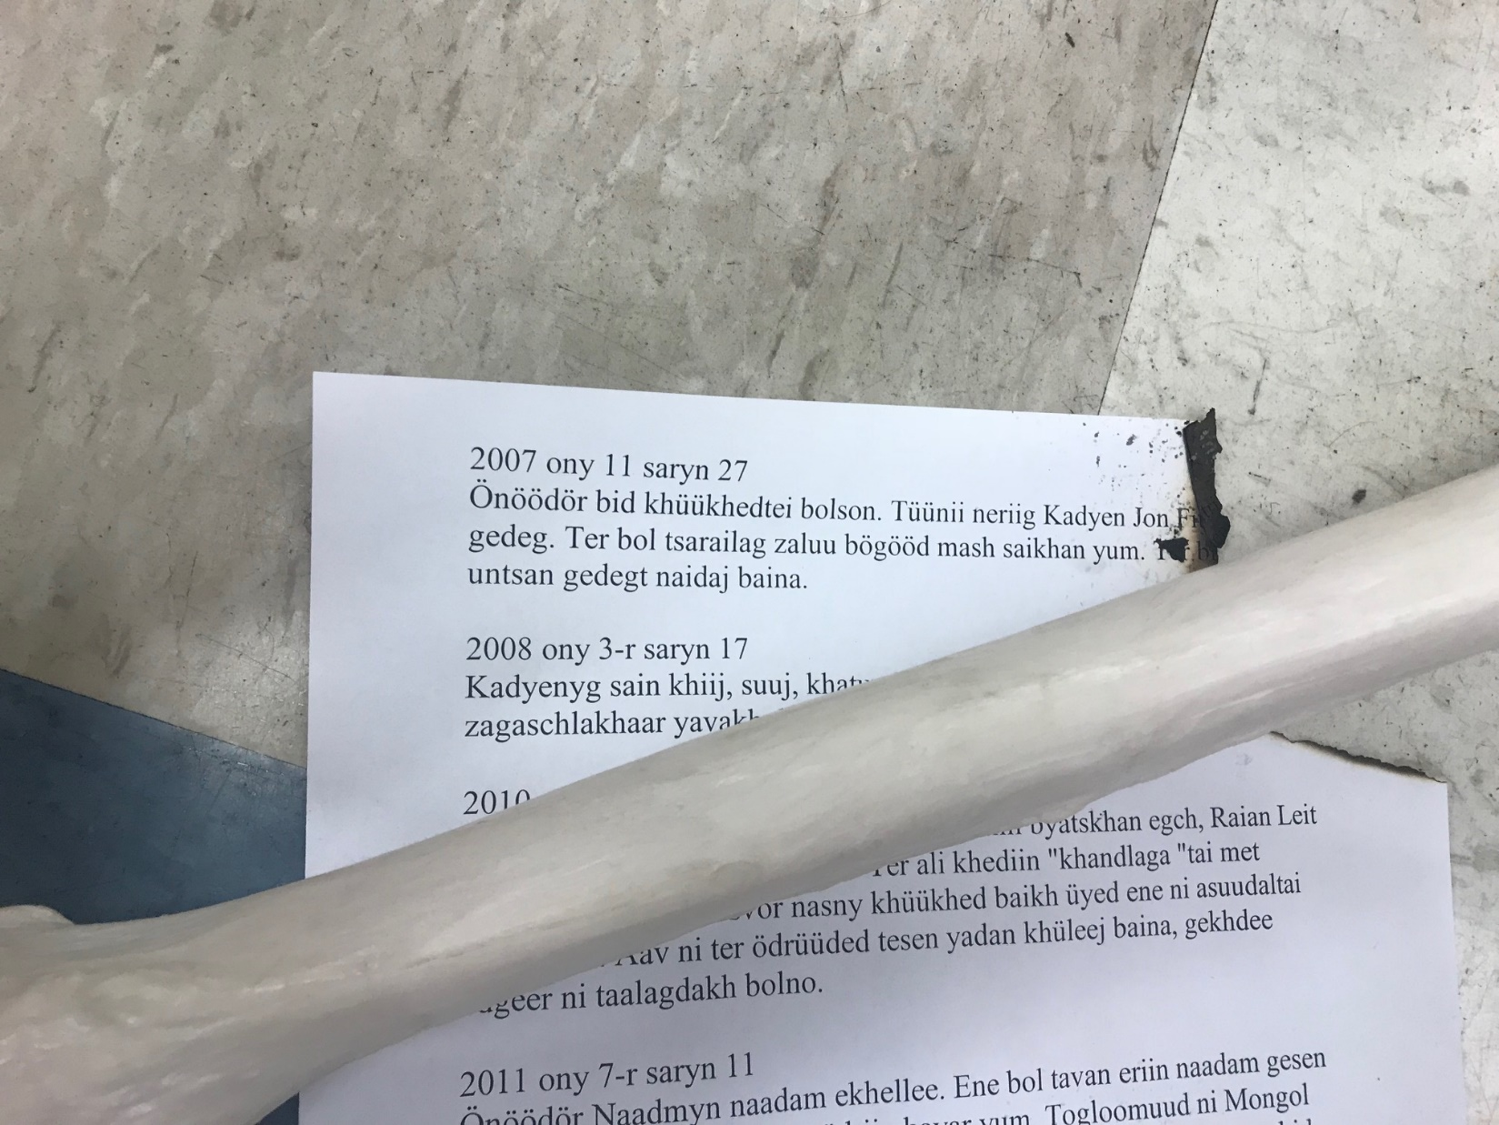
Letter For Period 6

Slide 13
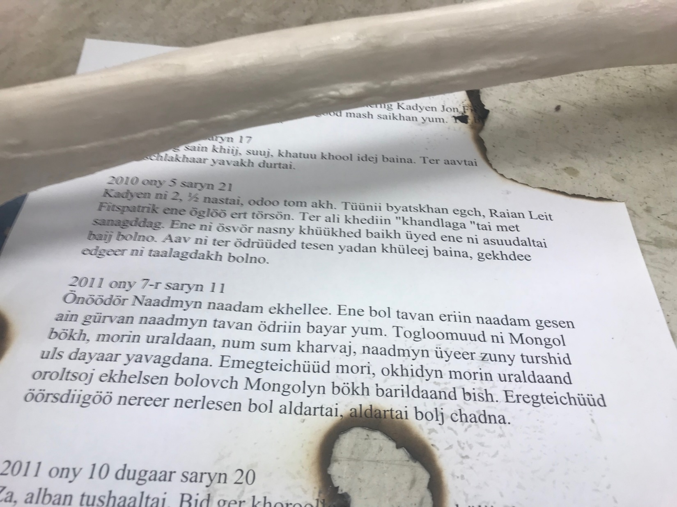
Letter For Period 6

Slide 14
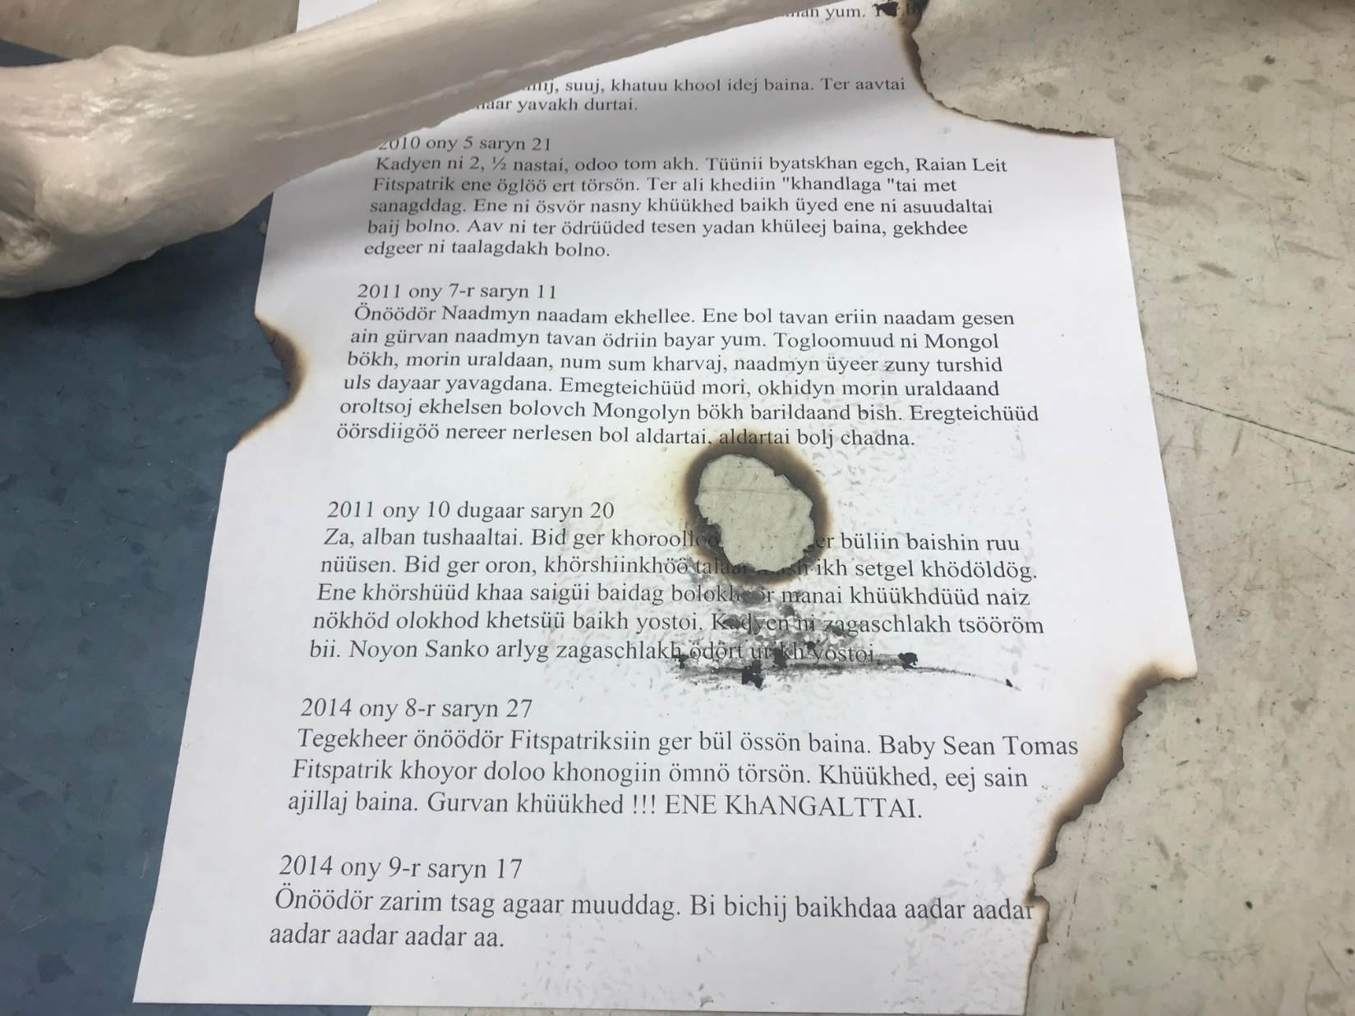
Letter
For
Period
6

