Slide 1
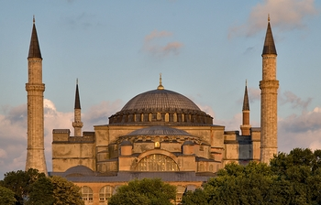
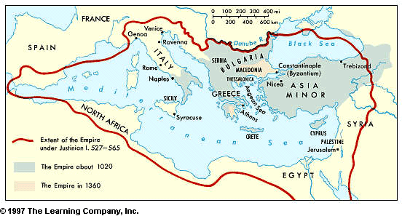
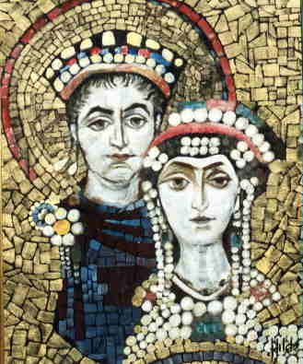
Emperor Justinian
Mr. Fitzpatrick

Slide 2
Learning Goals for “You.”
You will understand the impact Justinian had on the Byzantine people and later civilizations.
You will understand the Code of Justinian.
You will understand the relationship between Justinian and Theodora.
You will understand the importance of Theodora and her role in the empire.

Slide 3
Justinian’s Code
Finding the laws obscure because they had become far more numerous than they should be, and in obvious confusion because they disagreed with each other, he preserved them by cleansing them of the mass of their verbal trickery, and by controlling their discrepancies with the greatest firmness;
Procopius, historian and biographer of Justinian

Slide 4
Code of Justinian
Justinian came to the throne AD 527
Not content with merely reclaiming lands, Justinian also respected the laws of ancient Rome. In order to cement them into his time and his Empire, he called for all of Rome's ancient laws to be recorded. In doing this, Rome's ancient laws, also known as the Twelve Tables, were broken down into categories. Outdated laws were done away with, and complex laws were simplified.
Desiring the Empire to thrive, Justinian also added new laws dealing with the fair treatment of those within the Empire. For instance, one of his laws held that a person is innocent until proven guilty. This one should be very familiar to anyone who has sat in a history class or watched a TV cop show.
Justinian's new laws, together with the laws of ancient Rome, are known today as the Corpus of Civil Law or Justinian's Code of Laws. Completed around the year 529, these laws have formed the basis for the judicial systems of the Western world.
Yes, Justinian may not be as well-known as Caesar or Nero, but his influence just might be one of the strongest and longest-lasting of all the Roman Emperors.

Slide 5
Justinian and Theodora
Bear Keeper’s Daughter in the Blue Book.
Women’s Rights
“Empress”
Nika Riots

Slide 6
Nika Riots
Blues and the Greens
Hippodrome was a place where they could air their problems and get a response from the emperor.
Some members of both groups were arrested and sentenced to be hanged. The hanging was botched, and these men fled to a church, where they sought refuge.
At the Hippodrome, The Blues and Greens called out for their pardon and release.
They rioted, and tried to have Justinian ousted. Burned buildings, including the Hagia Sophia (St. Sophia/Holy Wisdom).
Justinian wanted to flee, but in stepped Theodora.

Slide 7
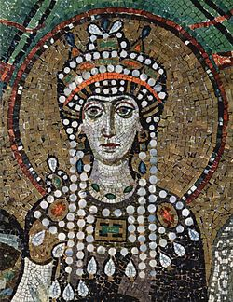
Theodora’s words to Justinian
"My opinion then is that the present time, above all others, is inopportune for flight, even though it bring safety. For while it is impossible for a man who has seen the light not also to die, for one who has been an emperor it is unendurable to be a fugitive. May I never be separated from this purple, and may I not live that day on which those who meet me shall not address me as mistress.” …Theodora
30,000 slaughtered

Slide 8
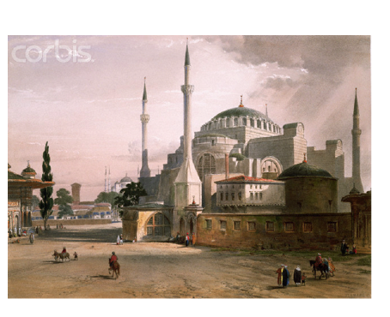
Hagia Sophia
St. Sophia
Holy Wisdom
Virtual Tour

Slide 9
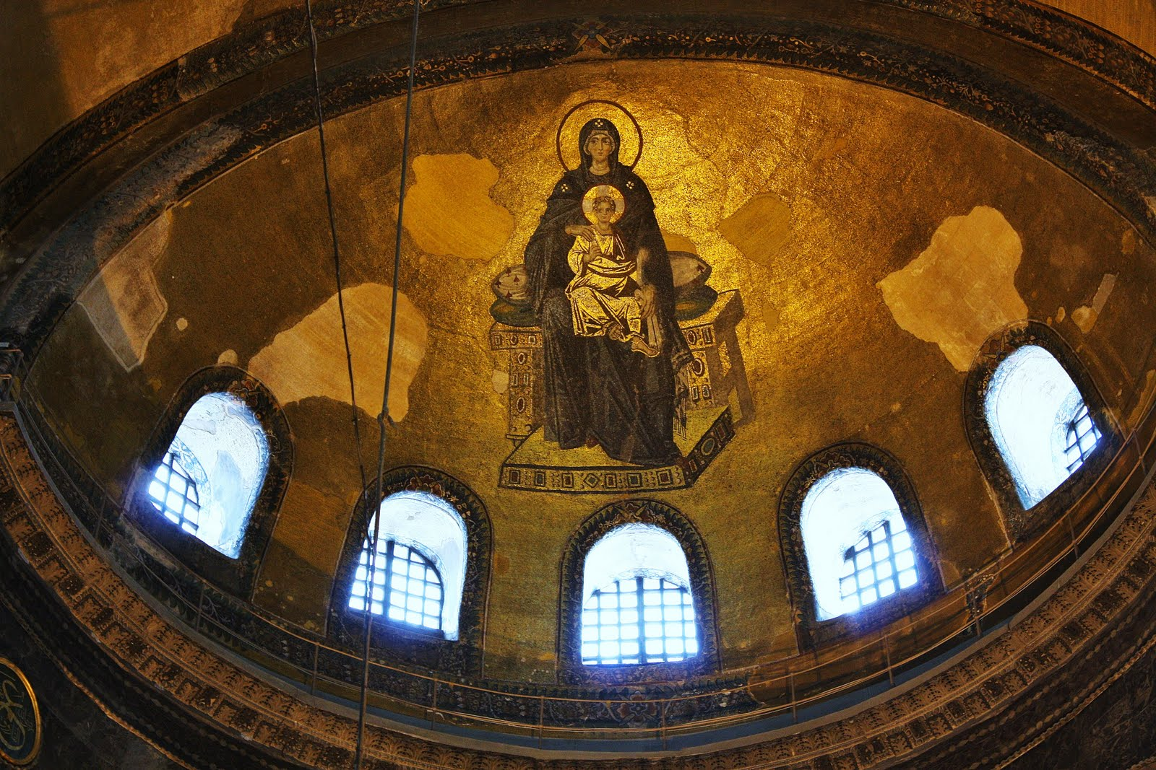
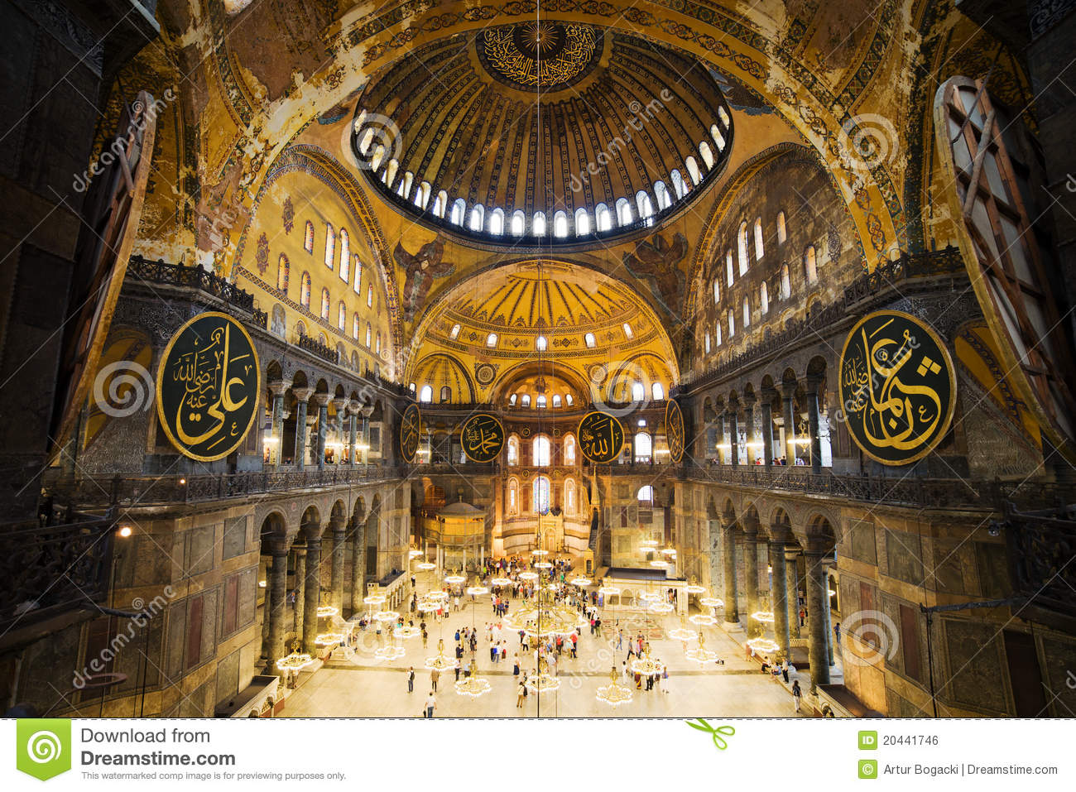

Slide 10
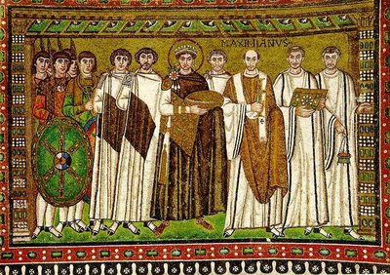
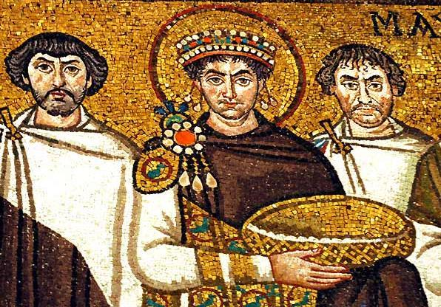
Reuniting the West with the East
Belisarius – Justinian’s greatest general, and one of Byzantium's Great Captains.

Slide 11
Justinian Timeline
525 Married Theodora
527 Becomes Co-Byzantine Emperor (sole emperor by 528)
528 The Code of Justinian
532 The Nika Riots
533 Reclaims northern Africa (Belisarius)
538 Goths take Rome, Belisarius takes it back
547 Goths take Rome, Belisarius takes it back
548 Theodora Dies
549 Goths take Rome again
562 Belisarius dies
552 Retakes Rome under General Narses
554 General Narses defeats the Franks
559 Belisarius saves Constantinople from the Bulgars
565 Justinian dies
532-537 Rebuilds the Hagia Sophia (Holy Wisdom)

Slide 12
Justinian’s Three Main Legacies were…
Organizing and rewriting the laws – Code of Justinian.
Rebuilding the Hagia Sophia.
Reuniting the Eastern and Western Roman Empire.

