Slide 1
Greek Legacies
Mr. Fitzpatrick
Something handed down from someone from the past.

Slide 2
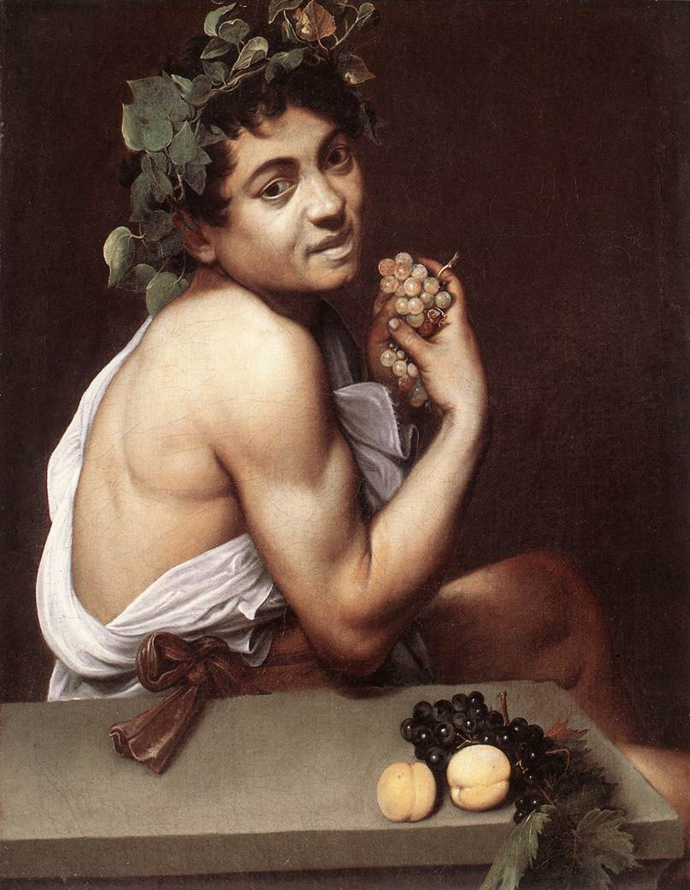
Theatre
Theatron=seeing place
Drama comes from Dran, which means “to do”
Dionysus

Slide 3
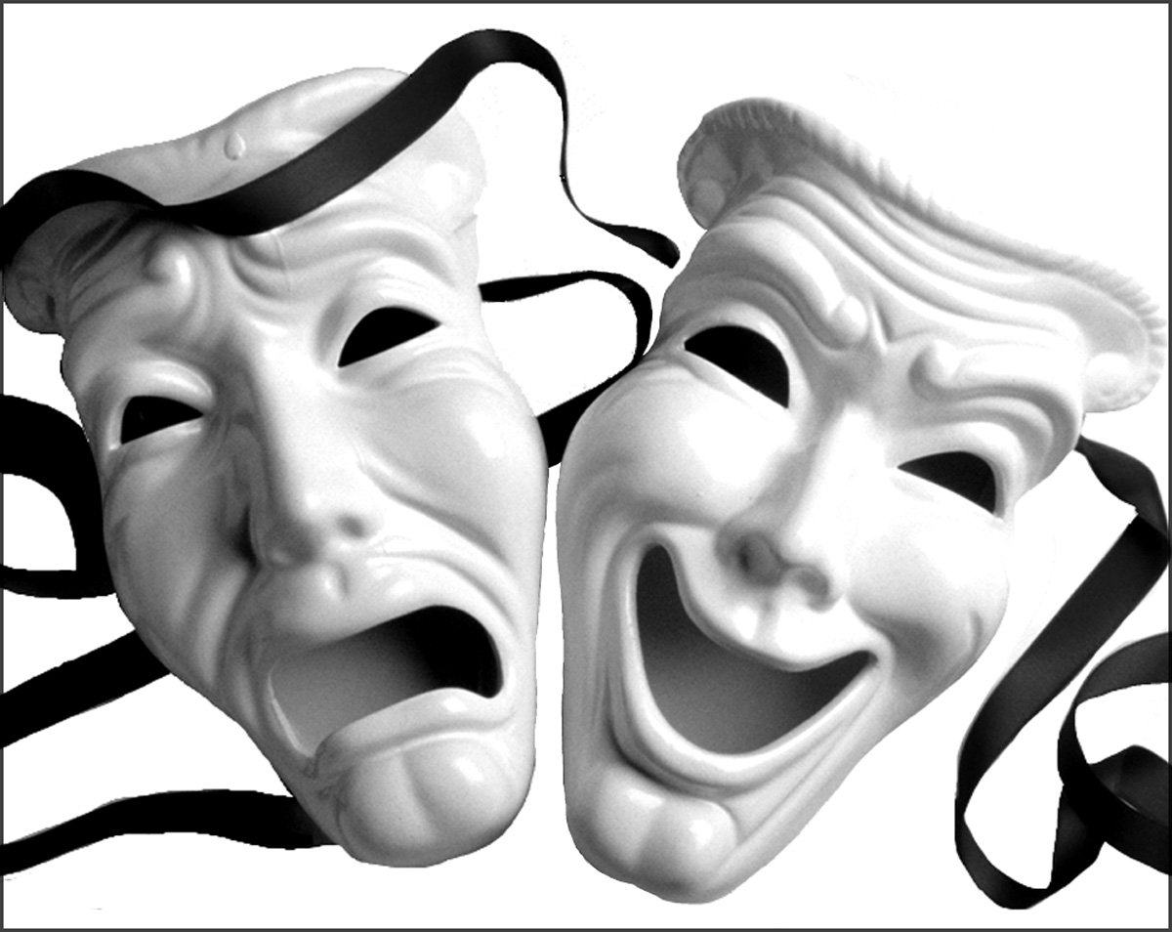
Theatre
Tragedy-Tragos
Sophocles
Euripides
Aeschylus, 2
Comedy-ODE
Aristophanes
Greek Theatre

Slide 4
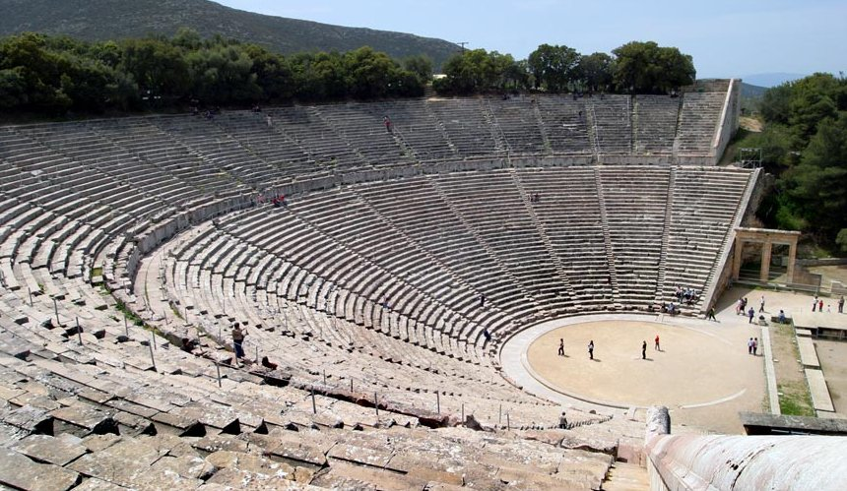
The Actual Greek Theatre
Click

Slide 5
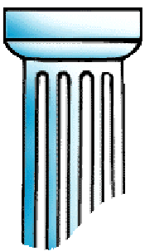
Greek Architecture (photos)
The ancient Greeks invented three types of columns.
Follow Up
Doric Style
Most Plain
Ionic Style
Famous for
its scrolls
Corinthian Style
Quite fancy
Do Anagram Activity

Slide 6
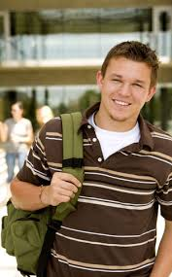
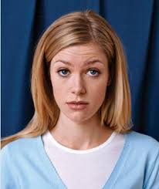
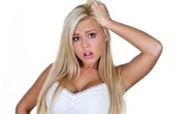
Today’s Learned Helplessness
Broken Escalator
Human Dystopia
My printer is broken
I forgot my book bag
I had soccer practice
I was sick
PROBLEM SOLVE

Slide 7
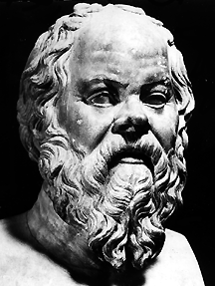
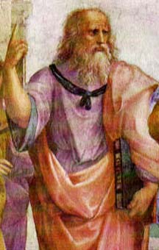
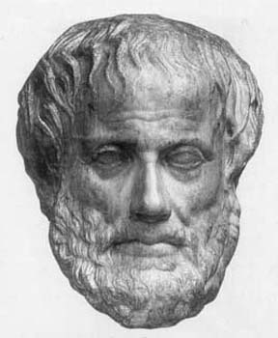
Philosophy
Song Parody
Socrates – Questioned life around him.
Plato – The Republic
Aristotle – Biology and the sciences.
The Socratic Method
The Thinkers
Allegory of the Cave
Explanation
Syllogism
Philosophers

Slide 8
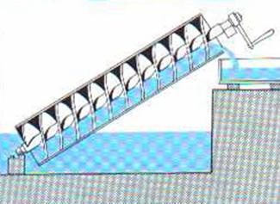
Science and Mathematics
Pythagoras – Pioneered the study of mathematics
Hippocrates – Father of Modern Medicine
Archimedes – Water displacement, the Archimedes Screw, and Pi.
Stupid Deaths
His Theory
Music
Visual Explanation
Advanced Look at his Life
Donald Duck
Analyze His Words
Old
On Public Health
New
Words we get from the Greeks
Hippocratic Oath
Horrible Histories
Eureka
Modern Archimedes Screw
Archimedes Screw
Ultimate City Defender

Slide 9
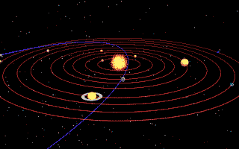
Science and Math
Anaximander – Earth is suspended in Space.
Democritus – Atomic Theory of the Universe.
Eratosthenes – Circumference of the Earth.
Ptolemy – Heavens revolved around the Earth.
Thales of Miletus – First known Greek Scientist

Slide 10
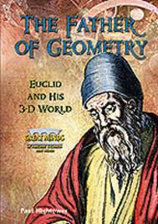
Euclid – The Father of Geometry
What’s the Point?
Triangles
Episode 3
Circles with Squares

Slide 11
Historians and Writers
Aesop – Fables that taught moral lessons. (my fable)
Hesiod – Greek Epic Poet – (Persian Wars)
Sappho – Female Greek lyric poet – Romantic Poetry.
Herodotus – Father of History. (Persian Wars)
Thucydides – Historian – (Peloponnesian War)

Slide 12
Herodotus
To the end that neither the deeds of men be forgotten by the lapse of time, nor that the works great and marvelous …. may lose their renown, and especially the causes may be remembered that for which these waged war with one another.
Sean’s interpretation… He didn’t let the things that men did be forgotten.
Noah says …To remember, and for future people to look and say, “Let’s not make the same mistakes, let’s do better.”

Slide 13
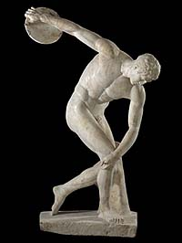
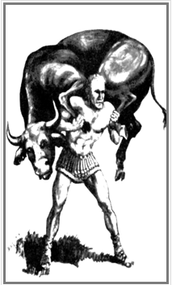
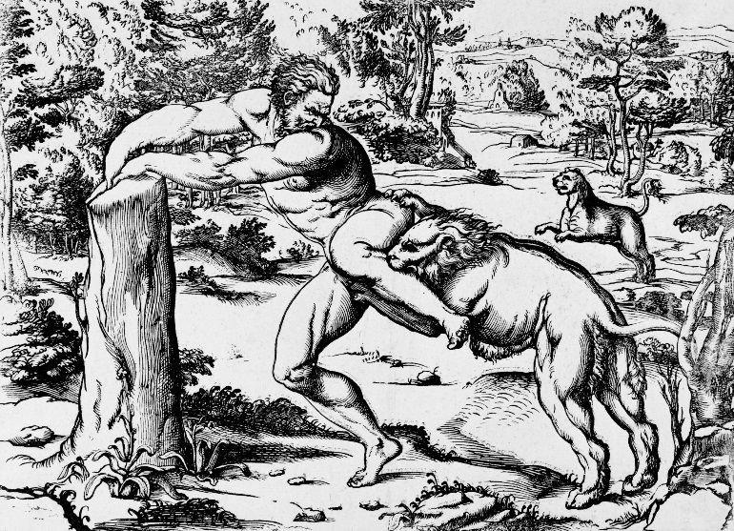
Olympics
776 BCE, but they probably began even sooner.
The Origins of the Olympics
The Events
The Time Warp Trio
Part 1 Part 2 Part 3
Olympic Moments
Greek Boxer
Milo of Croton
Kynisca of Sparta
Horrible Histories
Words we get from the Greeks

Slide 14
Big Quarterly Test Questions
T/F All of the following are true of the ancient Greek Olympics
Women were not permitted to watch.
Non-Athenians were not allowed to compete.
They were held in honor of the god Zeus.
The events in the games were created to help men prepare for war.
T/F All of the following are true about early Greek theater?
Both male and female actors were popular among the audiences.
Actors wore masks to show emotion and amplify their voices.
Plays were held in large, open-air structures called Amphitheaters built on the slopes of hills.
Greek playwrights were famous for writing plays of tragedy and comedy.
Early Greek philosophers were important because they were the first people to
consider real explanations for events in nature, not just the work of the gods.
The many achievements of ancient Greece were important because
they strongly shaped western civilization.

Slide 15
Greek Legacies
Today’s Problems, Yesterday’s thinkers.
Royals Song
Words we get from the Greeks
Things we get from the Greeks

