Slide 1
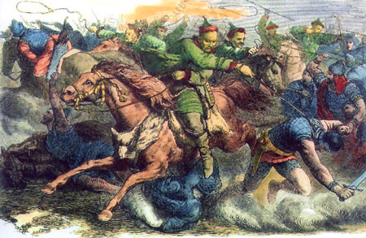
The Huns
What do you already know about them?
Germanic or Not Germanic??

Slide 2
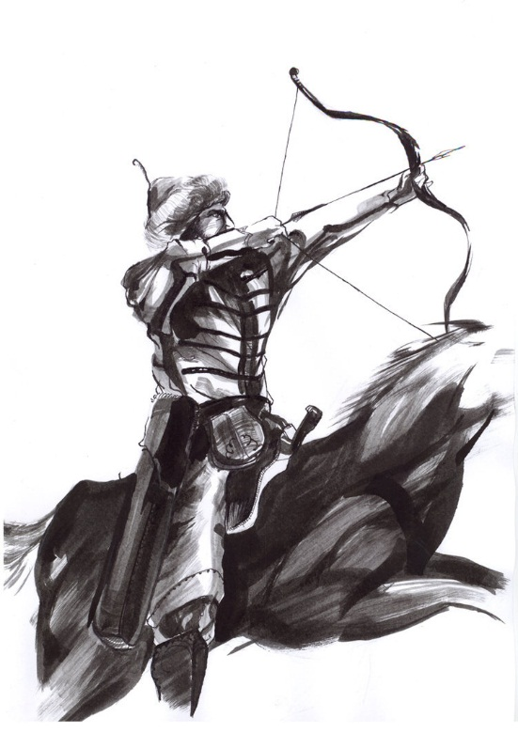
The Huns
Mr. Fitzpatrick
The Huns were a group of nomadic (roaming) herdsmen,
warlike people from the steppes (grasslands) of North
Central Asia north of China (Mongolia) who terrorized,
pillaged, and destroyed much of Asia and Europe from the
3rd through 5th centuries.

Slide 3
Their Influence on the Fall of Rome
The Huns were forced out of Asia by the Chinese. They swept into Europe, scaring the Visigoths into the Roman Empire in 376 CE, which eventually went bad for the Romans. The Visigoths sacked Rome in 410 C.E.
They also caused the Vandals to move, and they also eventually sacked Rome in 455 C.E.
Under the leadership of Rugulas, the Huns attacked the Eastern Roman Empire in 430 C.E., forcing the Romans to pay huge tributes of gold to the Huns or face more destruction.
After Rugulas died, Attila and his brother Bleda took over, but Attila would kill his brother. In 451 C.E., Attila invaded Gaul but was defeated by Roman and Visigothic forces This was Attila’s first and only defeat. In 452 the Huns invaded Italy and sacked several cities, but perhaps famine and pestilence compelled them to leave, or ……
Read the Blue Book page 34, but stop before the Pope’s visit.

Slide 4
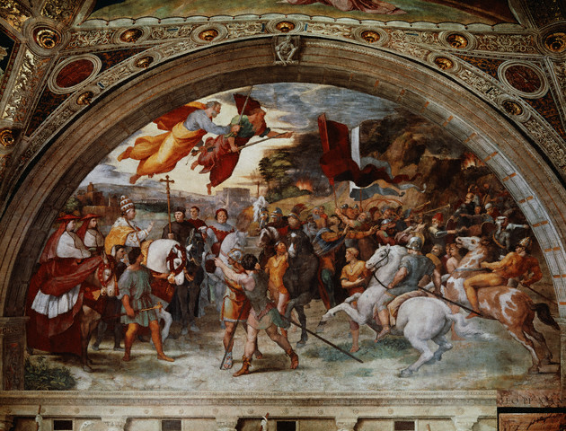
Back to Slide 3

Slide 5
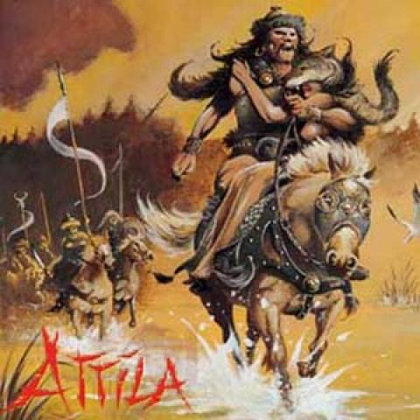
Famous Ruler of the Huns - Attila
Attila was a fifth-century warrior, born around 406 AD, who helped unite the Hun kingdom, in an area that is now Hungary.
He led his Huns on a series of conquests, looting and pillaging wherever he went. Attila acquired a vast empire, that stretched through parts of what is now Germany, Russia, Poland, and much of south-eastern Europe.
He came to be known as the "Scourge of God", because of the devastation he brought on the Roman Empire.
Atilla died following the celebration of his marriage in 453 AD, and his empire crumbled soon after his death.

Slide 6
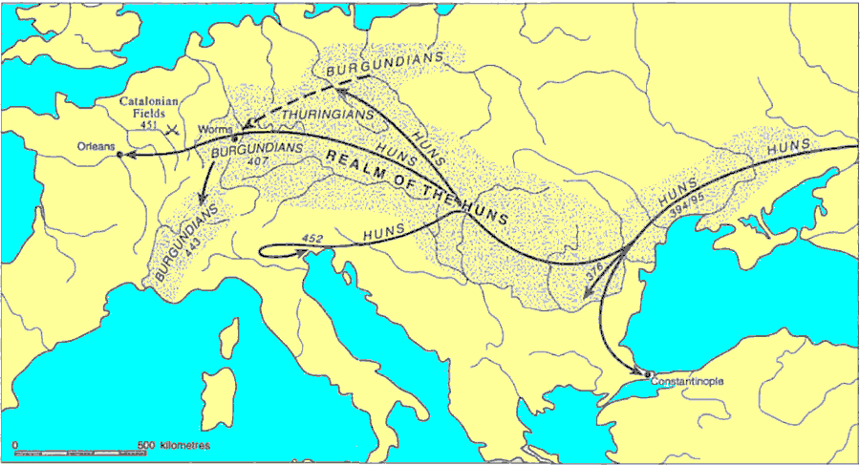
Movement and Settlement and of the Huns

Slide 7
200 B.C.E.
The Chinese build the Great Wall of China to keep the Huns out.
350 CE
Huns arrive in Eastern Europe, killing off some Germanic tribes, and forcing others into the Roman Empire.
430 C.E.
Rua becomes king of the Huns, and signs peace treaty with Eastern Roman Empire, requiring huge sums of gold for peace.
453 C.E.
Attila dies on his wedding night, and the Hunnic Empire begins its decline.
445 C.E.
Attila becomes the sole ruler of the Huns. Captures Romans forts, invades northern Italy, but has to turn back.
Song Parody

