Slide 1
Preview 1 – Seed Activity Preview 2 – See below
Whom do you consider the most influential person in the history of the world? What effect did this person have on others? How did the government in power react to this person?
100 most Influential
Many scholars have suggested that Jesus Christ is the most influential historical figure, since the religion he founded has the greatest number of followers. This lesson will explore the development of Christianity and its effect on life in the Roman Empire. But first, we will begin with a review of Judaism.

Slide 2
The Beginnings of Christianity
History Alive
Mr. Fitzpatrick

Slide 3
Learning Goals
The students will understand the direct link between Judaism and Christianity.
The students will explain how Jesus’ life and teachings formed the basis of Christianity.
The students will trace the spread of Christianity.
The students will understand how the church was organized.
The students will understand the relationship between Christianity and the Roman society before and after the time of Constantine.

Slide 4
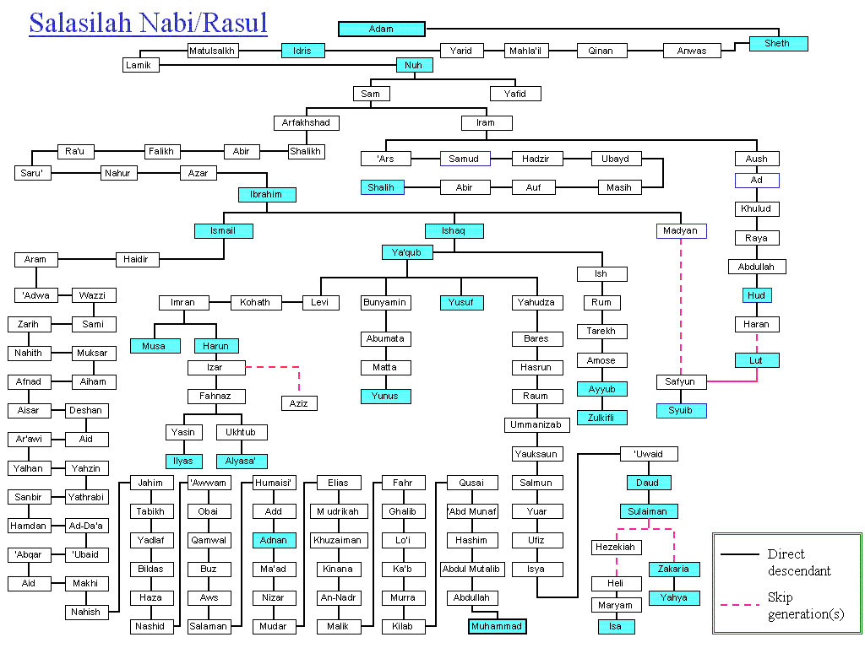
Passover

Slide 5
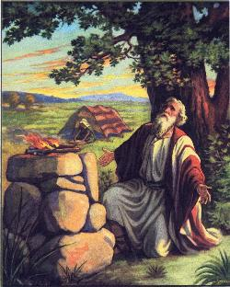
The Beginnings
Noah (Trailer 2 ½ minutes)
Abraham – 1800 BCE (a long time before Jesus Christ)
His Covenant with God (Reading)
Family Tree
Abraham and Isaac (Bible Series 3 minutes)
Jacob and Esau (Birth rite reading)
Animated Moses (Jingu Kid 7 ½ minutes)
Moses is sent down the river (Old movie 2 min)
Prince of Egypt - Burning Bush (Animated Movie 5 min)
Moses parts the Red Sea (Heston Clip 2 min)
Moses Trailer
The Ten Commandments (Heston Clip 2 min)
David Vs Goliath Animated (Jingu Kid 6 ½ minutes)
David Vs. Goliath (Bible mini series 3 ½ minutes)

Slide 6
Passover

Slide 7
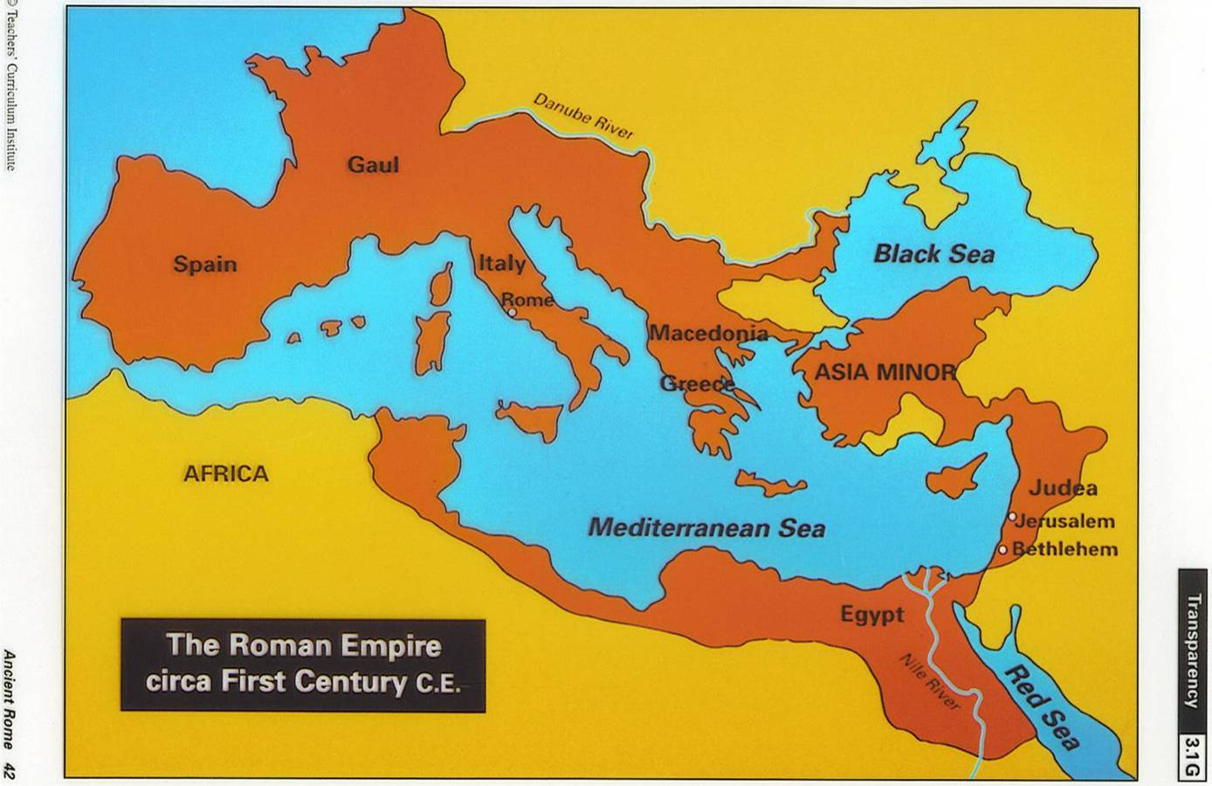

Slide 8
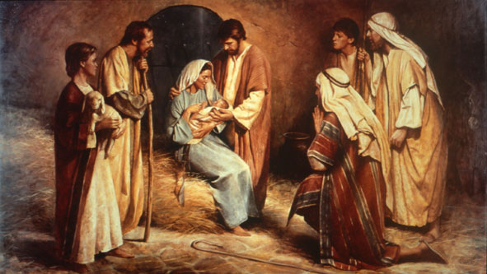
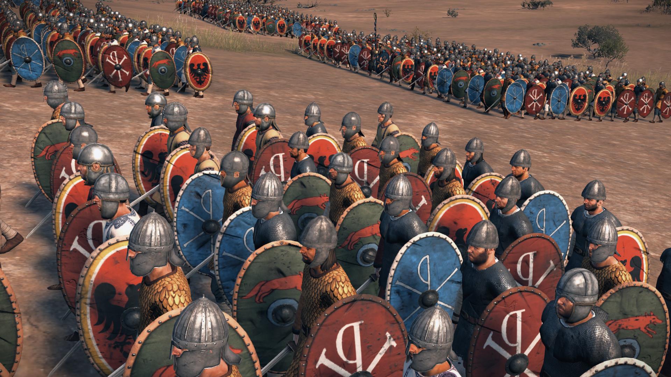
36.1 Introduction
From
To

Slide 9
36.2 Judea: The Birthplace of Christianity
Why was their unrest in Judea after it came
under Roman rule?
Jews did not want to be ruled by Romans.
Saw Herod as a Roman Puppet
Herod’s kingdom was divided amongst his sons
Religions were different
Did not trust each other
How did the Roman prefect rule Judea?
Kept order
Made sure Judea paid $ to Rome
Left local affairs to the Jews

Slide 10
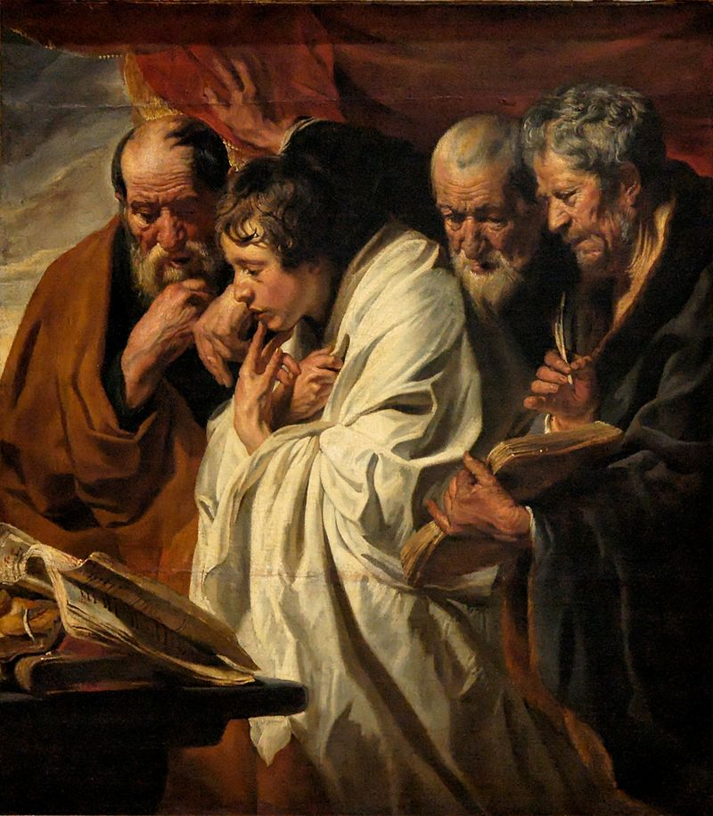
36.3 Writings About the Life Of Jesus
What are the gospels?
Accounts of Jesus’ life that were written in Greek by four of his followers. Gospel means “good news.” They were written to spread the news of Jesus’ life and teachings.
Who wrote the gospels, and when were they written?
Matthew, Mark, Luke, and John wrote the Gospels.
They were written down 30-70 years after Jesus died.

Slide 11
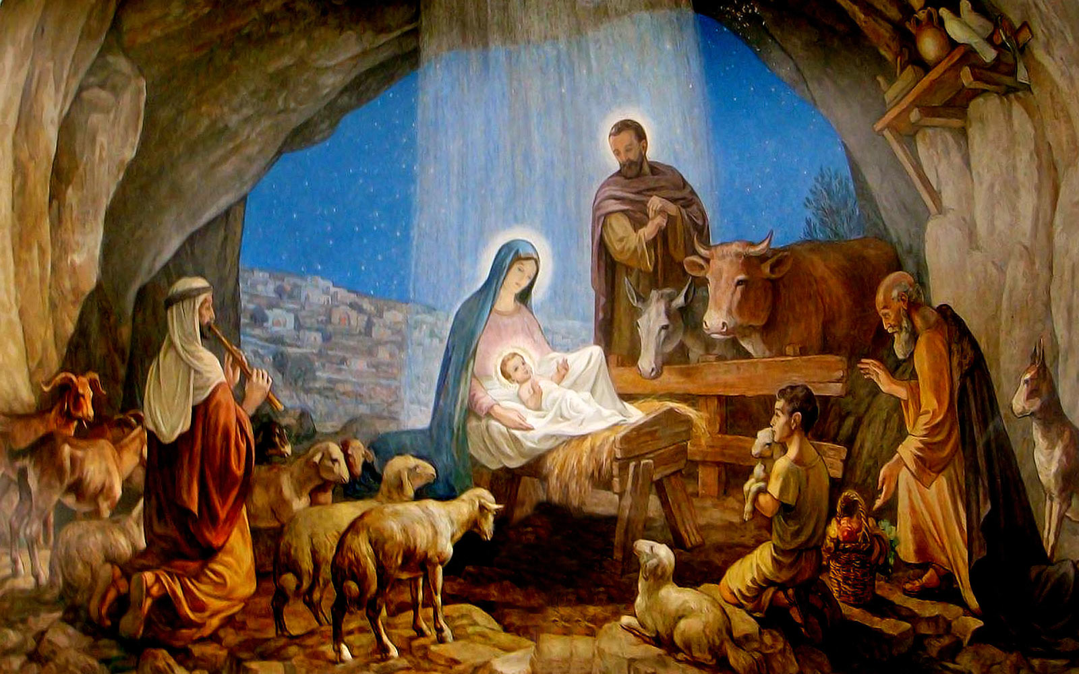
36.4 The Birth of Jesus
Mary is caring for the baby.
Joseph is the man standing behind a woman with a baby.
The child is Jesus, the first born son of Joseph and Mary.
The baby Jesus is wrapped in swaddling clothes.
The animals and hay show that this event takes place in a stable, and why there would be a manger.
About 30 years later… - Baptized

Slide 12
Key Points
Mary lived in Nazareth
Emperor Augustus was taking a census, or count of the people.
Each man had to return to the town of his birth to be counted.
This is why they were traveling to Bethlehem, where Joseph was born.
Jesus probably learned carpentry, Jewish law, and religion.
Jesus was baptized by John the Baptist around the age of 30. He began preaching just after this event.

Slide 13
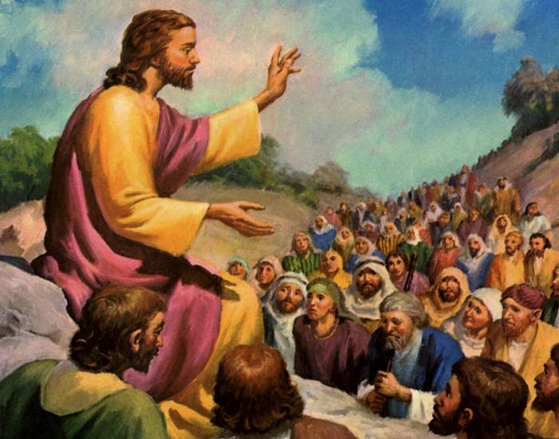
36.5 Jesus’ Teachings
Jesus may have gestured with his arm raised as he taught them.
These people are the crowds that Jesus taught.
Jesus recruits Disciples
The person who sat down is Jesus.
This sloped area indicated that Jesus went up on the mountain.
These men seated close to Jesus are his disciples.
Parable: The Good Samaritan

Slide 14
Key Points
As Jesus’ reputation spread, he preached in open areas.
Closest followers were called his disciples.
Spent most time with ordinary people, the poor, and the sick.
Teachings were based on traditional Jewish law, with an emphasis on love and mercy.
Two most important laws were to “Love your God with all your heart and soul, and “love your neighbor as yourself.”
Jesus spoke of heavenly kingdom, not an earthly one.
Taught using stories called parables, so people could relate.
Teachings shocked and angered some listeners. Some Jews thought his way of thinking was wrong and dangerous, and could stir up trouble with the Romans. But Jesus did not preach revolt against the Romans.

Slide 15
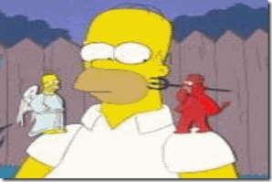
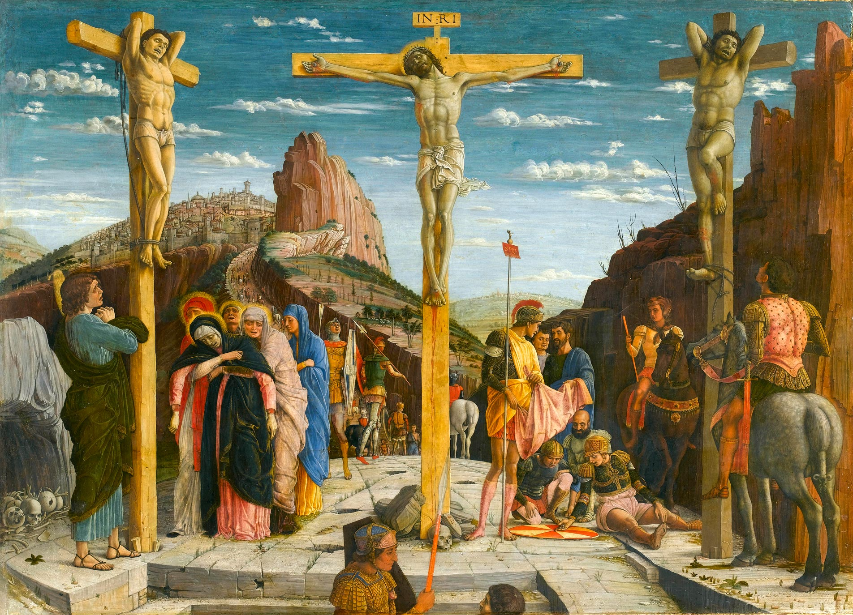
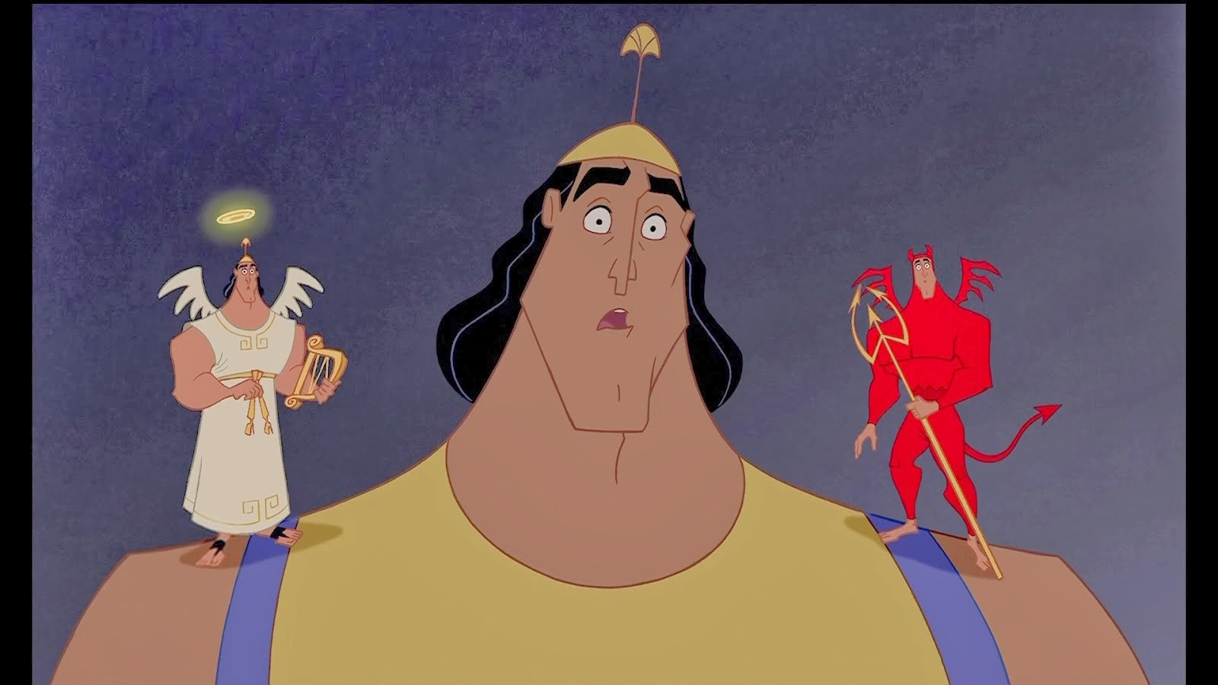
36.6 The Crucifixion and Resurrection
This sign shows that Pilate wrote a title and put it on the cross.
Jesus was crucified on a cross.
This portion of the image indicates that this event is taking place on Golgotha, a small hill outside of Jerusalem.
These two figures are the two others, one on either side, who were crucified along with Jesus.
These Roman soldiers took Jesus and crucified him.
Right=Righteous=Correct
Left = sinister=sin

Slide 16
Key Points
Roman soldiers kept any large demonstrations from happening.
Jewish priests accused Jesus of claiming to be the Son of God.
When Roman’s heard him referred to as “King of the Jews,” they decided he was becoming too powerful and a threat to Roman rule in Judea.
He was condemned to a rebel’s death, crucifixion.
Belief in the Resurrection convinced Jesus’ disciples he was the Son of God.

Slide 17
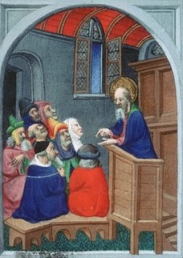
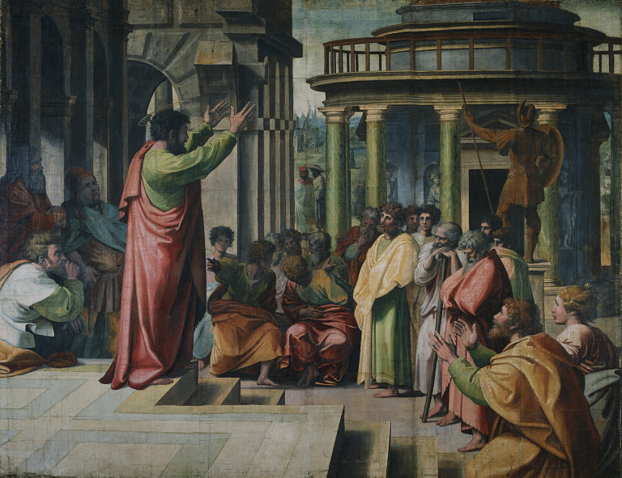
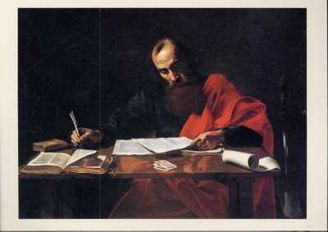
36.7 The Missionary Work of St. Paul
The Conversion of Saul
Visit by Ananias
He is Paul, who preached the Kingdom of God.
This is an example of how Paul welcomed all who came to him.
St. Paul continued to write in his dwelling while under house arrest.
These papers indicate that Paul is teaching about the Lord Jesus Christ through his writings.

Slide 18
Key Points
Saul was a Greek speaking Jew who persecuted Christians.
He was knocked form his horse and blinded, while receiving a message from God.
He was healed by a Christian, and became convinced Jesus was the Messiah, becoming a Christian missionary.
He attempted to convert non-Jews, otherwise known as Gentiles.
He allowed converts to not have to adopt all Jewish customs.
He traveled throughout the Empire.
Was captured, jailed, and then killed by Romans who began to persecute Christians.

Slide 19
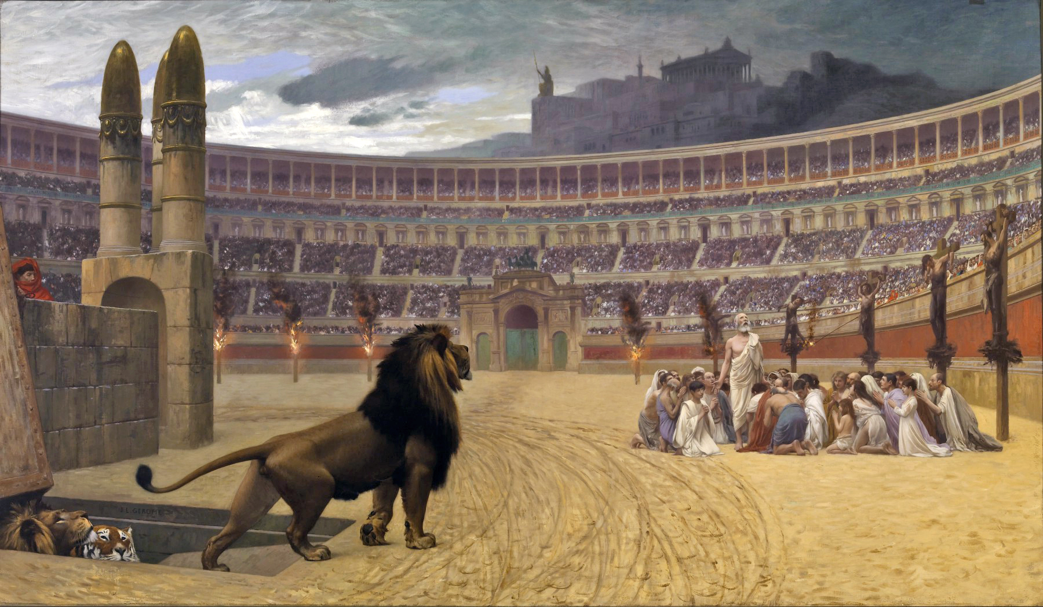
36.8 The Persecution and Triumph
The crowd is made up of Romans whom Peter refers to when he writes have no fear of them.
These huddling Christians are reverencing Christ.
The lion shows how the Romans made Christians suffer by feeding them to wild animals.

Slide 20
Key Points
At first, Christianity was not seen as a threat.
Christians would not acknowledge the Roman gods, and they would not worship the emperor as a god either.
They refused to serve in military too.
The number of Christians grew large, and became a threat to Romans.
Persecutions actually led new admirers to the religion. They faced death so bravely, with their beliefs in tact.
Christianity offered people a sense of hope and purpose, especially the poor and slaves.

Slide 21
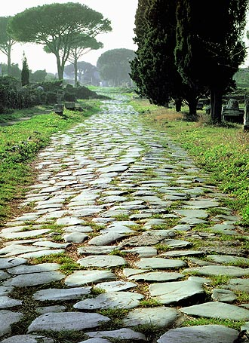
Christianity Continues to Spread
Pax Romana helped the spread of Christianity
The roads helped
The language helped (Latin or Greek)
Christians won new admirers by facing death so bravely, offering people a sense of hope and purpose.
Appealed to Plebeians, all could get to heaven, not just the wealthy.

Slide 22
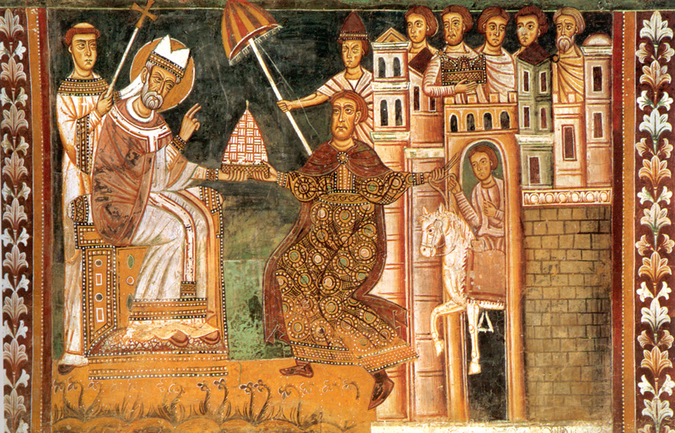
The Donation of Constantine
More power was given to the church as an institution.

Slide 23
Constantine’s Conversion
Following this Constantine went on to defeat the numerically stronger army of Maxentius at the Battle at the Milvian Bridge (Oct AD 312). Constantine saw this victory as directly related to the vision he had had the night before. Henceforth Constantine saw himself as an 'emperor of the Christian people.’ If this made him a Christian is the subject of some debate. But Constantine, who only had himself baptized on his deathbed, is generally understood as the first Christian emperor of the Roman world.
Constantine later claimed to have had a vision on the way to Rome, during the night before battle. In this dream he supposedly saw the 'Chi-Ro', the symbol of Christ, shining above the sun. Seeing this as a divine sign, it is said that Constantine had his soldiers paint the symbol on their shields.
On DVD, Play using VLC:
minute 9-11:35
minute 12:29-16:15
in hoc signo vinces
"in this sign you
will conquer"

Slide 24
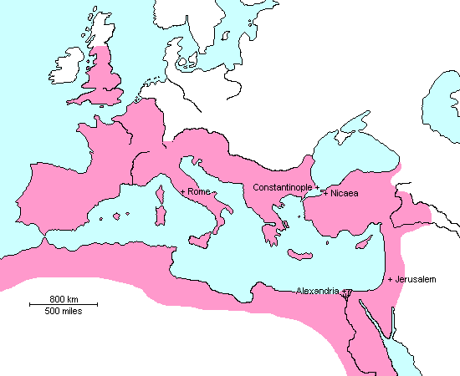
Constantine
Changed the capital of the Roman Empire, from Rome in the West, to Byzantium in the East.
He renamed Byzantium “Constantinople” (It is now called Istanbul)
Why? It was where the East meets the West
From here
To here

Slide 25
39.9 Summary
In this chapter, you learned how Christianity was born in Judea. You read about Jesus Christ and his followers. And you saw how the new religion survived harsh persecution and gradually spread throughout the Roman Empire. Eventually, it outlasted the mighty empire itself.
Although the Roman Empire fell more than 1,500 years ago, its influence has lasted to this day. The Christian religion became part of the legacy of ancient Rome.
Next, you will explore factors that caused the Roman empire to fall.

