Slide 1
ISLAM
The World’s Second Largest Religion

Slide 2
Goals
The students will understand the meaning of the word Islam.
The students will be able to explain Muhammad’s life and how it led to the development of Islam.
The students will be able to recall the name of the Islamic God, the Five Pillars of Islamic Faith, and the Holy Book of the Muslims.
Crash Course

Slide 3
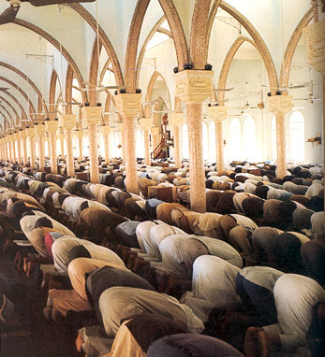
Islam
Arabic word – “giving oneself over to the will of God”
  Monotheistic religion
Founded by Muhammad
  Prophet of Allah (“the God”)
Followers of Islam = Muslims

Slide 4
Islam→ A Religion Going back to Abraham
Muslims are strict monotheists.
They believe in the Judeo-
Christian God, which they call
Allah.
Muslims believe that the Torah
and the Bible, like the Qur’an,
is the word of God.
Peoples of the Book

Slide 5
Abraham’s Genealogy
HAGAR
ABRAHAM
SARAH
Ishmael
Isaac
12 Arabian Tribes
Jacob
Esau
12 Tribes of Israel

Slide 6
The Prophetic Tradition
Adam
Noah
Abraham
Moses
Jesus
Muhammad

Slide 7
Muhammad
Blue Book
Born in 570 A.D. and became a successful businessman
Upset with the way people lived
  Selfishness – gambling, drinking, corruption in Mecca
Angel Gabriel visited him = revelation (vision)
Began to preach about one God, Allah
Saw life as a preparation for the Day of Judgment

Slide 8
Mecca (Makkah)
Largest and richest city in western Arabia
Supported by trade and religion
  Traders on their way to Constantinople
  Pilgrims came to worship at Arabia’s holiest shrine, the Ka’bah, that is filled with idols (many gods)

Slide 9
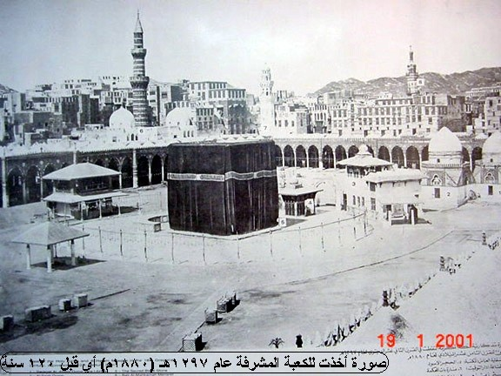
1880

Slide 10
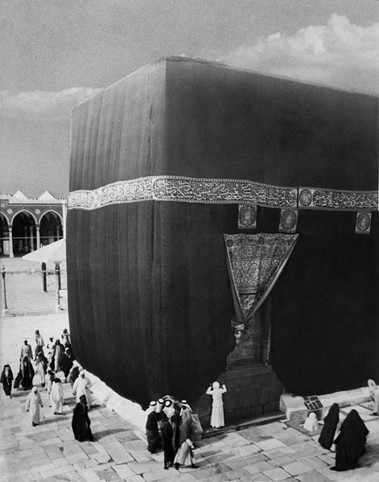
1910

Slide 11
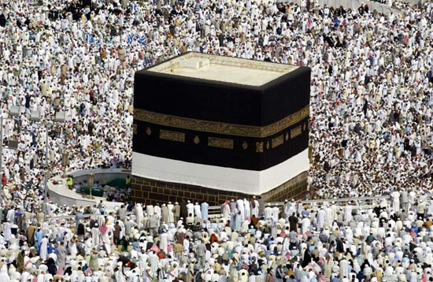

Slide 12
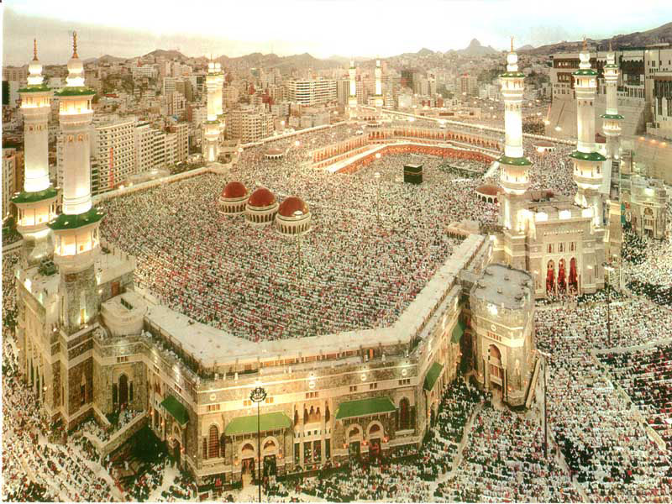
Live Streaming
Humanities – Golden Ratio

Slide 13
Muhammad
Rich people felt threatened
  No more pilgrims will visit Mecca and buy their goods
Started to persecute Muhammad
Fled to Yathrib [Madina] in 622 (“Year of Migration”)
  First year of Muslim calendar
  630 – peaceful takeover of Mecca
  632 – Muhammad Dies
Caliph – The leader of the Muslim community who succeeded Muhammad after his death.

Slide 14
Islamic Schism (split)
Sunni
Shia
Smaller group
Believed caliphs should be descendants of Ali (Muhammad’s son-in-law)
-Pillars of Islam
-recognize each other as Muslims
Larger group
Followed Rightly Guided Caliphs

Slide 15
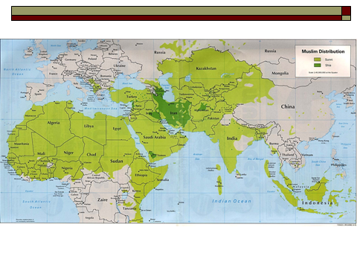

Slide 16

By the end of the lesson you will:
Know what is meant by the ‘Five Pillars of Islam’.
Understand why the Five Pillars of Islam are important to Muslims.

Slide 17
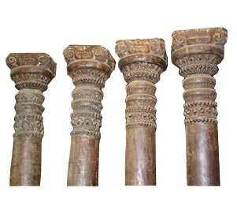
Pillars
In the Middle East every house was supported on pillars.

Slide 18

Pillars
What would happen if one of the pillars of a house was removed?
It would become weaker or may even collapse.

Slide 19
The Five Pillars of Islam
The religion of Islam is like a house supported by five pillars.
These are five rules or principles that a Muslim must follow.
The Five Pillars of Islam help a Muslim to worship Allah and guide his daily life. In doing so, they are fully supporting Islam and it helps him/her to be a better Muslim.
A true Muslim will try to keep all Five Pillars of Islam.

Slide 20
The Five Pillars of Islam.
islam
Shahadah
Salat
Zakat
Sawm
Hajj
F
A
I
T
h
P
R
A
Y
E
r
G
I
V
I
N
g
F
A
S
T
I
N
g
P
I
L
G
R
I
M
A
G
e

Slide 21
Pillar One – The Shahadah
If you want to join a group, a club or a community, you may have to make a promise or statement to show that you share and agree with their rules, practices or beliefs.

Slide 22

Pillar One – The Shahadah
As pupils of Richboro Middle School you have agreed to be:
Happy
Hard-Working
Courteous

Slide 23

Pillar One – The Shahadah
What other organizations have you joined?
Did you have to do or say anything in particular to become a member?

Slide 24
Pillar One – The Shahadah
To become a Muslim, a person must say the SHAHADAH.
This is a declaration of faith. It is a statement of what the person believes.

Slide 25

The Shahadah
“There is no God but Allah, and Muhammad is his messenger.”

Slide 26
When is the Shahadah said or heard?
In the call to prayer five times per day.

Slide 27
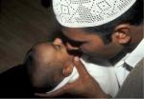
When is the Shahadah said or heard?
A Muslim father whispers the words of the Shahadah into the ear of their new born baby.

Slide 28

When is the Shahadah said or heard?
Muslims, who know that they are going to die, try to make the Shahadah their last breath.

Slide 29
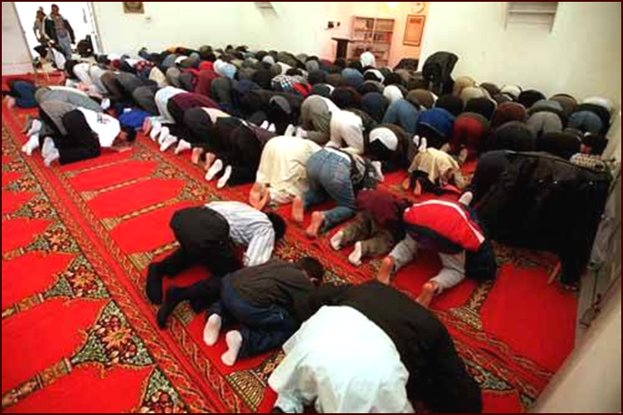
Prayer
Prayer
Muslims must pray five times a day, facing Mecca
  Dawn, noon, late afternoon, sunset, evening
Mosque – Muslim house of worship
Imam – prayer leader

Slide 30
Giving (Alms)
Charity
Muslims believe that all things belong to God
Muslims must give 2.5% of their income

Slide 31
Fasting
Fasting
Must fast each year from sunrise to sunset during the holy month of Ramadan
  Ramadan – ninth month of the Muslim lunar calendar

Slide 32
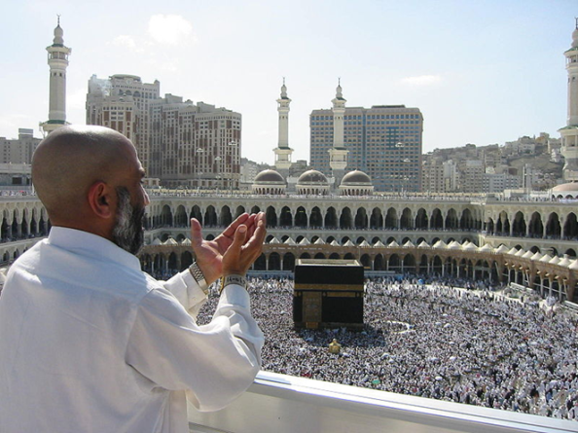
Pilgrimage
Live Webcam
Pilgrimage
Each Muslim must travel to Mecca two months after Ramadan at least once in his/her lifetime
2-3 million Muslims make the pilgrimage every year.

Slide 33
In The News
http://www.newsweek.com/theres-no-place-terror-teachings-islam-314437
http://www.usatoday.com/story/opinion/2015/03/18/christianity-isil-islam-religion-column/24847699/

Slide 34
Review
Tomorrow, there will be a test on Islam.
Time to study, but how?
Get together with a partner (no groups)
Get index cards and create flashcards
Study your sheet.
Rewrite your sheet.

