Slide 1
Pompeii
By Mr. Fitzpatrick
Richboro Middle School
Lesson Plan

Slide 2
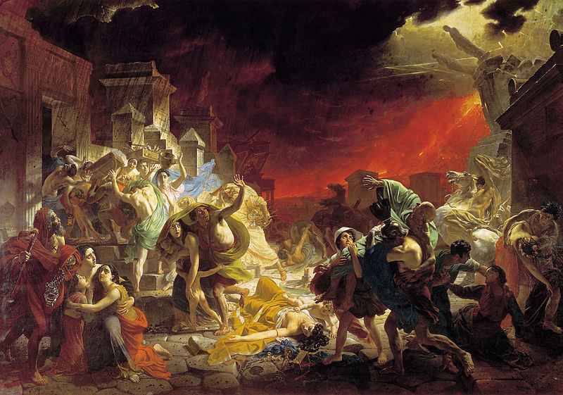
Music

Slide 3
Objectives
The students will locate and identify geographic features around Pompeii.
The students will evaluate the reasons for and importance of archaeology.
The students will analyze primary sources.
The students will examine archaeological artifacts and infer meaning and use of said artifacts.
The students will interpret history through artifacts, arts, and media.
The students will work collaboratively in groups.
The students will use what they have learned about archaeology and recreate a scene based on archaeological artifacts and primary source documents.

Slide 4
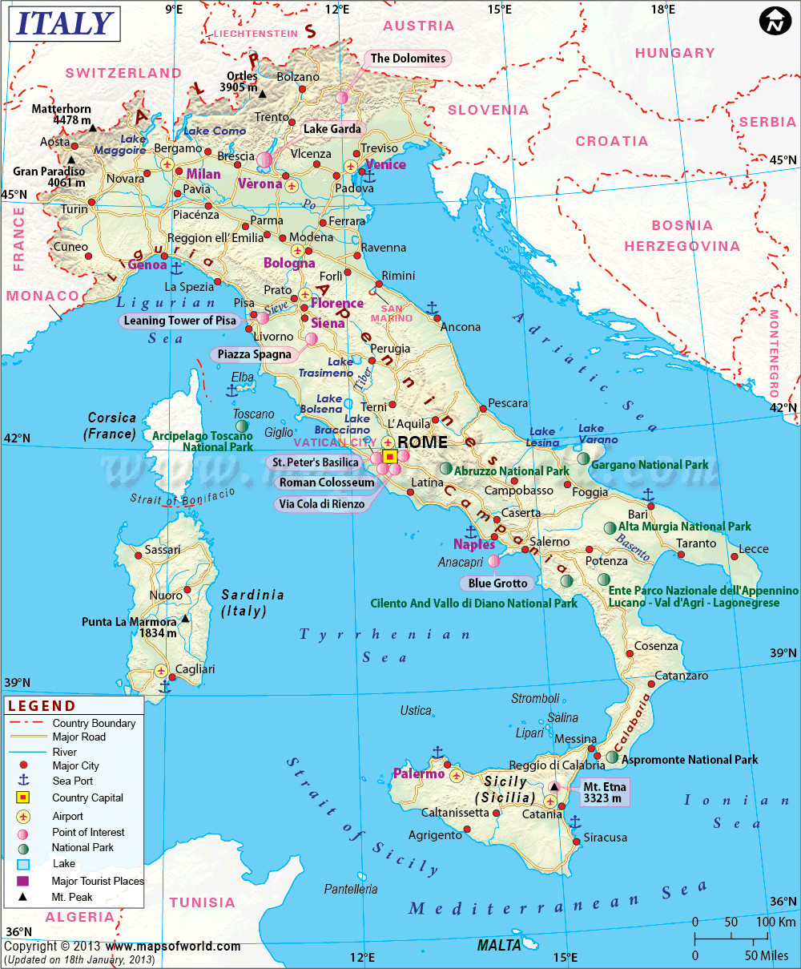
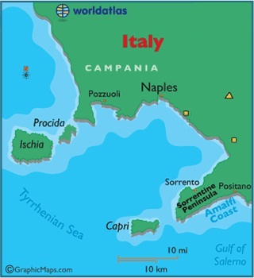
Mt. Vesuvius
Herculaneum
Pompeii
Bay of Naples

Slide 5
Pompeii - Artifacts

Slide 6
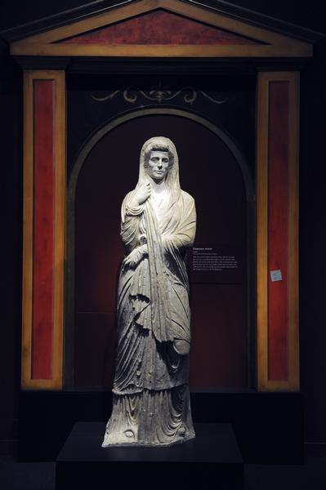

Slide 7
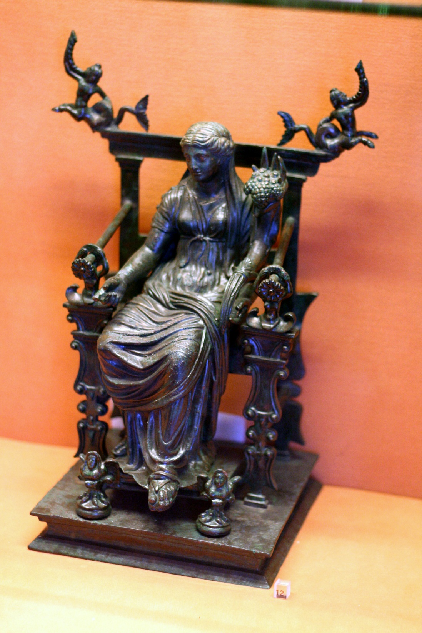

Slide 8
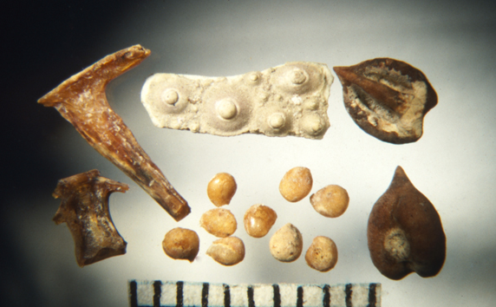

Slide 9
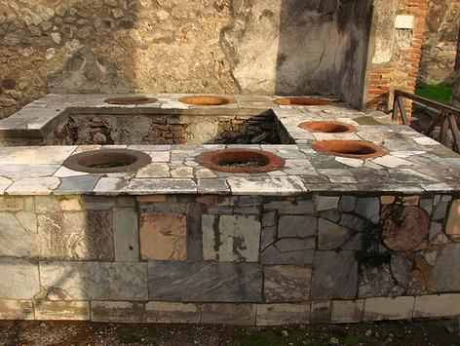

Slide 10
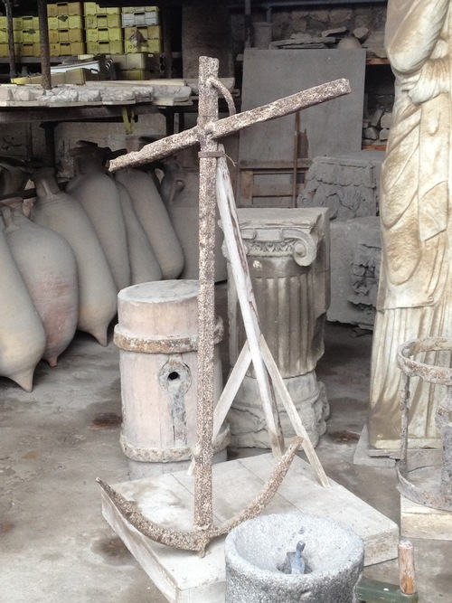

Slide 11
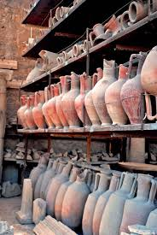
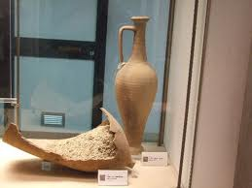
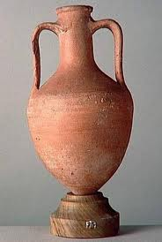
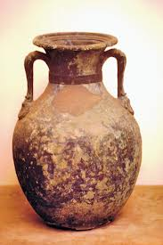

Slide 12
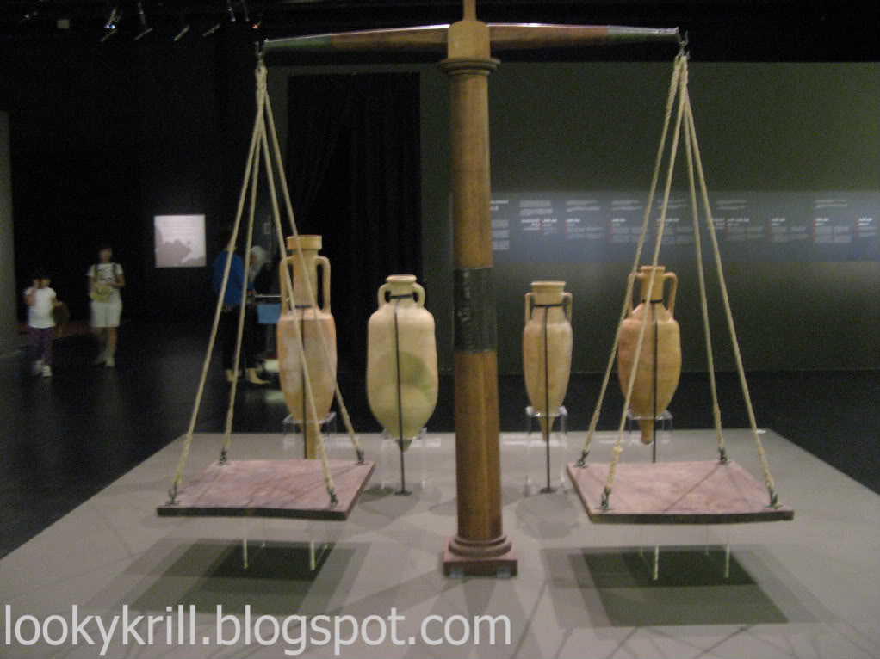

Slide 13
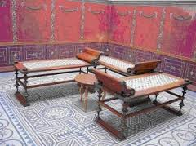
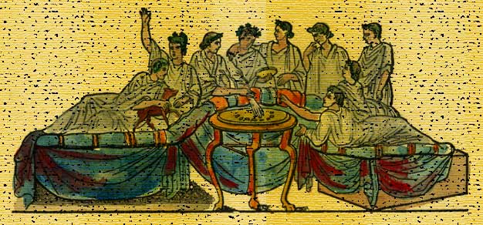

Slide 14
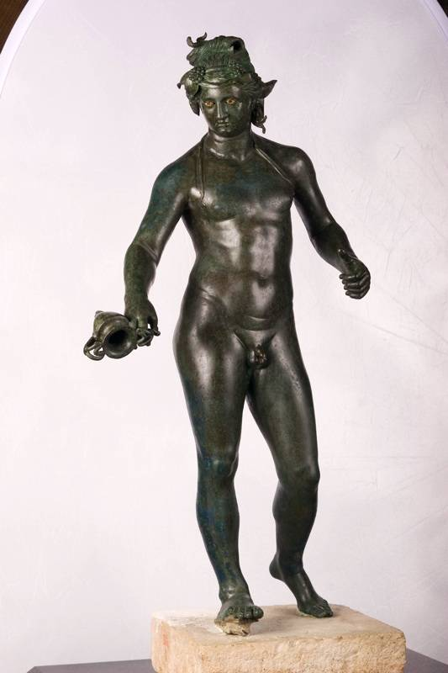

Slide 15
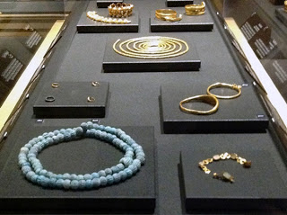

Slide 16
Pompeii – Molds of Victims

Slide 17
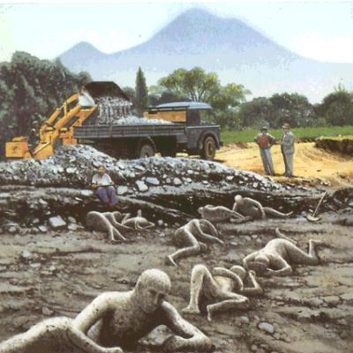

Slide 18
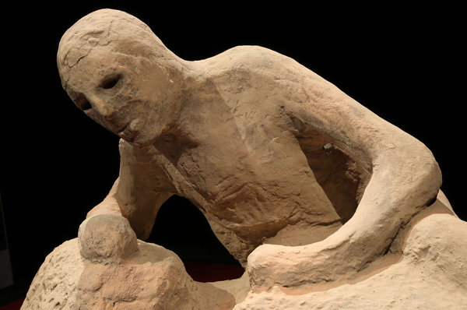

Slide 19
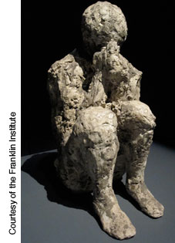

Slide 20
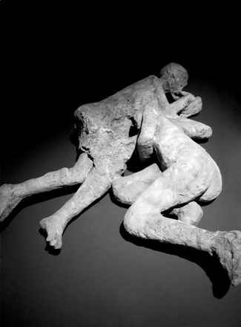

Slide 21
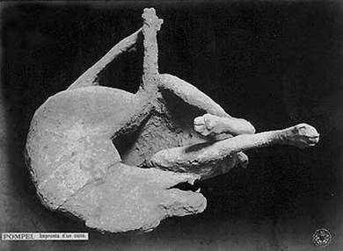

Slide 22
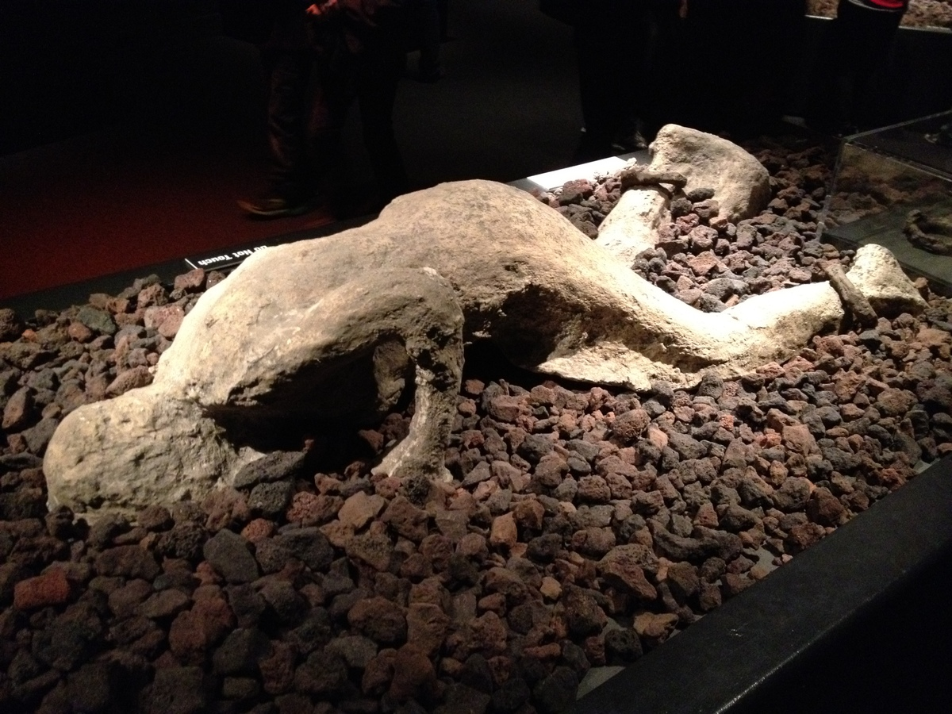

Slide 23
The Role of the Archaeologist
What does an archaeologist do?
In addition to the excitement of excavation, archaeology is linked with lots of other disciplines — history, geography, biology, chemistry or sociology, for example:
Archaeologists work with the material remains of past activities including artifacts, such as pottery or coins, built structures, refuse from all sorts of activities, industrial wastes, trace molecules and isotopes, and even the remains of the people themselves.
Archaeologists frequently work with historians concerned with ancient texts such as letters, court records, king-lists and political documents.
Archaeologists are interested in patterns of settlement, communications and trade, and much of our work is based on mapping in one form or another
Like physical geographers we need to understand past processes of erosion and deposition, and the implications of climate change for past societies.
The biological sciences have much to offer archaeology because people in the past adapted their lives to the environment utilizing plants and animals around them for food and other purposes (sometimes defined as ‘past human ecology’).
Aspects of archaeology and forensic science also coincide in methods used in crime-scene investigation or in determining the ‘age at death’ (archaeological methods are routinely used by police forces to solve crimes).
The physical sciences are involved as well, whether in the means of locating sites by surveying minute differences in the Earth’s magnetic field, or the analysis and conservation of artifacts in order to ascertain the technological processes in their manufacture.
Above all, archaeology is about people. It is truly a science for the humanities.

Slide 24
LIVE IT

Slide 25
Science Museum of Minnesota
Audio Tour
Play

Slide 26
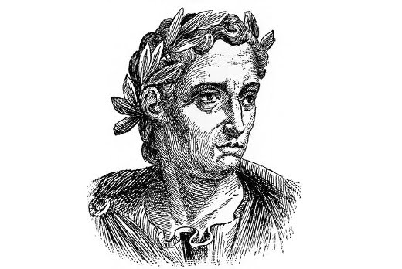
Pliny the Younger’s First Hand Account
Eyewitness Account in text

Slide 27
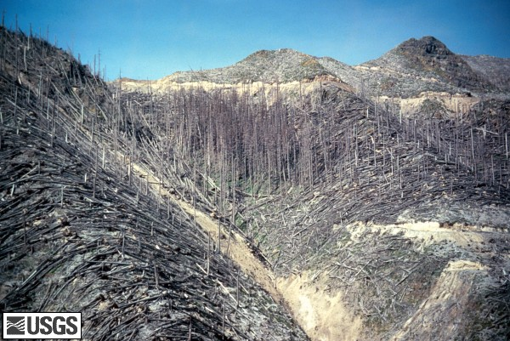

Slide 28
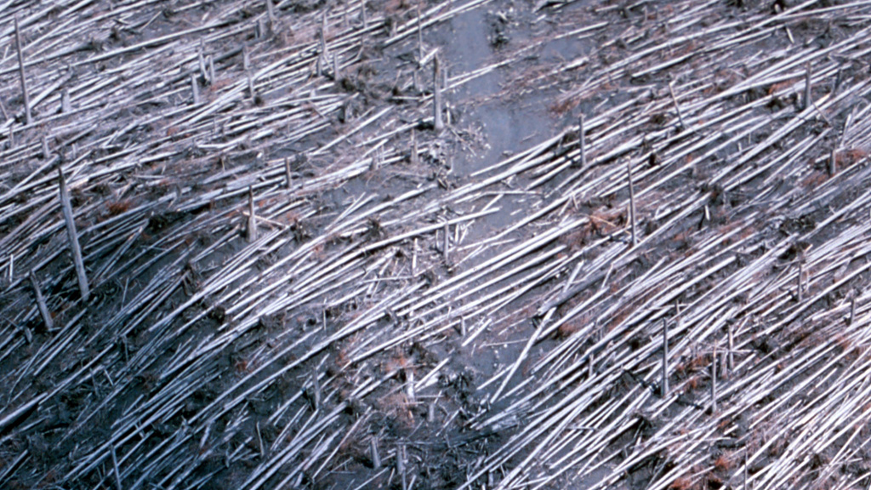

Slide 29
Pompeii
25 Facts about Pompeii
The Riddle of Pompeii
The Private Lives of Pompeii

Slide 30
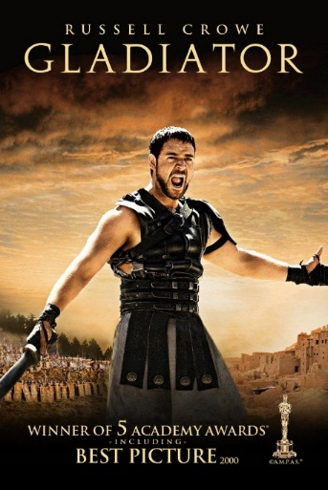
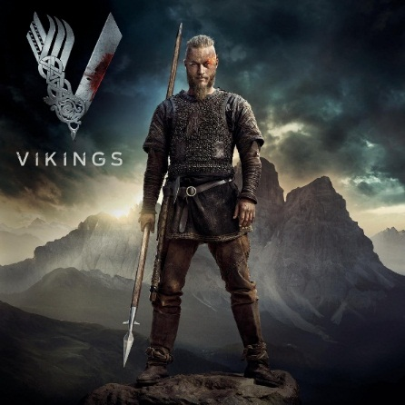
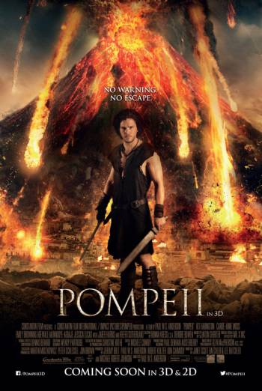
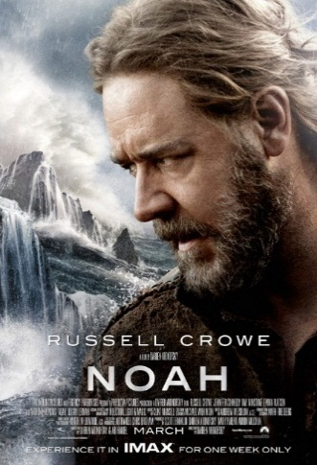
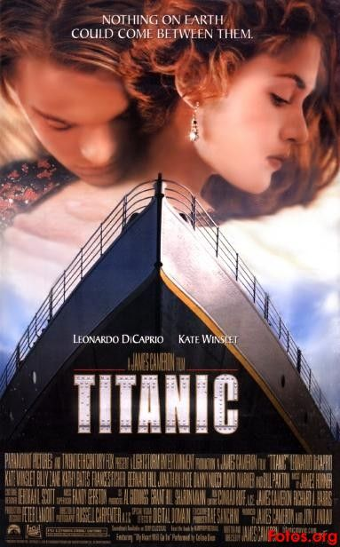
Evidence
Conjecture
What is Conjecture?

Slide 31
A word to use when you are not sure of something and have to "guess or surmise.

Slide 32
Archaeology
How are archaeologists able to recreate an event based on evidence?

Slide 33
Pompeii, the Last Day - BBC
Follow up Questions
How accurate does the film appear to be?
What is conjecture?
Conjecture is an opinion or conclusion formed on the basis of incomplete information.
What is based on the evidence?
What is based on conjecture?
Tomorrow, you will examine a dig site. The items have already
been excavated. It is your job to examine the items, sketch
them, etc. Once you think you have enough information, you
are going to recreate the event based on the evidence, and perhaps
some of your own conjecture. You will work in dig groups, using iPads,
to do all of this. How might you be able to use the iPad?

Slide 34
Archaeological Dig Site
Today you will examine a dig site THAT HAS NOTHING TO DO WITH POMPEII, OR ROME. IT IS A MODERN SITE. You learned about archaeology in our studies on Pompeii. Now apply what you have learned. The items have already been excavated. It is your job to examine the items, sketch them, etc. Once you think you have enough information, you are going to recreate the event based on the evidence. Add a little conjecture, and we have a story. Imagine a director wants to take your story and create a 60 minute documentary.
Rules
You may not touch the items.
You may work as a group, and write one recreation, but all must be involved.
Your stories will be shared in class on the next school day.

