Slide 1
Romanesque or Gothic
You are going to look at six different images, and will be asked to guess if it is the Romanesque or Gothic style of architecture, both used in the Middle Ages and the Renaissance. Think like a scientist does when he is identifying animals or plants. Look for similarities and differences. Be ready to share what criteria you used when guessing.

Slide 2
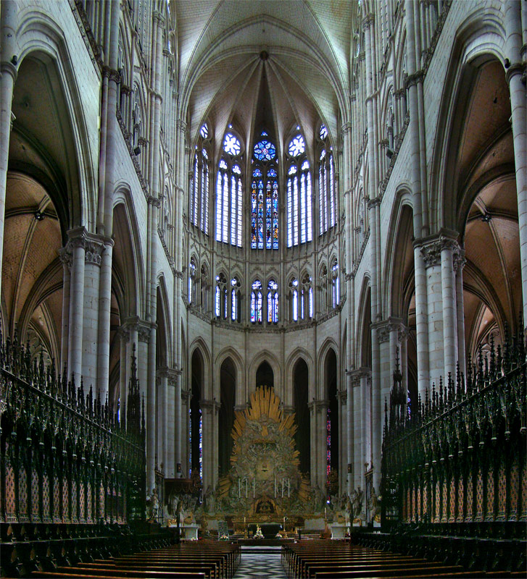
1)
Gothic (G) or Romanesque (R)
Why did you guess what you guessed?

Slide 3
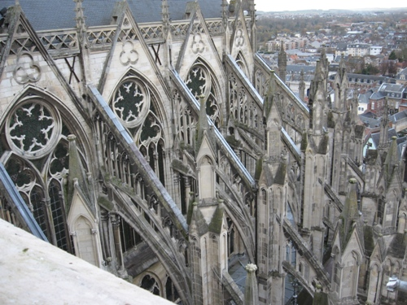
Gothic (G) or Romanesque (R)
2)
Why did you guess what you guessed?

Slide 4
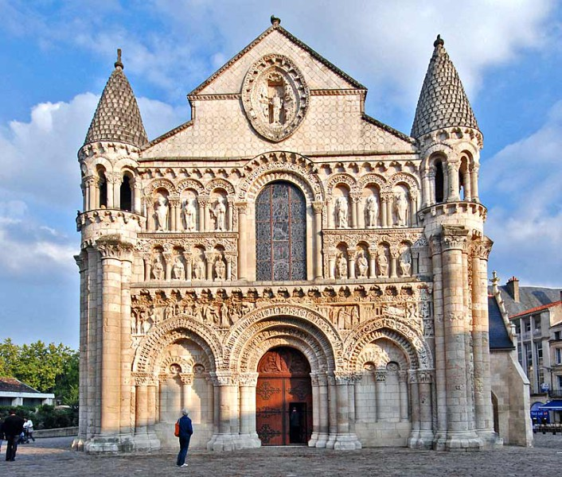
Gothic (G) or Romanesque (R)
3)
Why did you guess what you guessed?

Slide 5
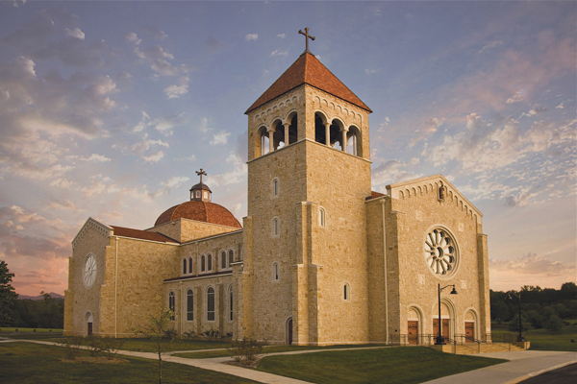
Gothic (G) or Romanesque (R)
4)
Why did you guess what you guessed?

Slide 6
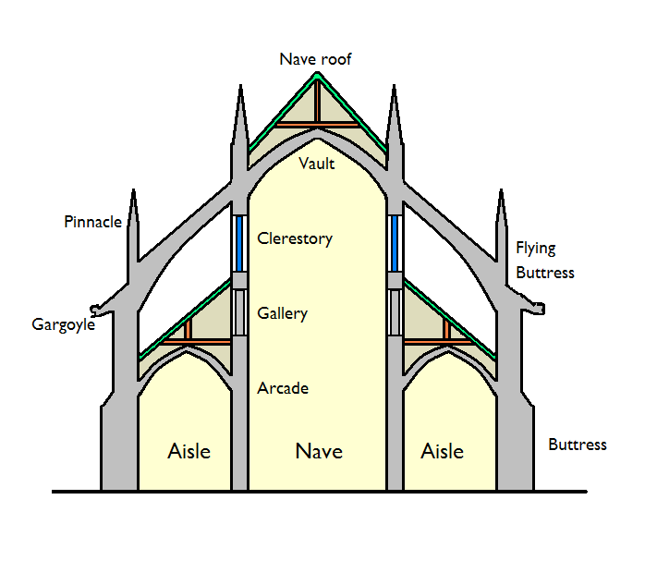
Gothic (G) or Romanesque (R)
5)
Why did you guess what you guessed?

Slide 7
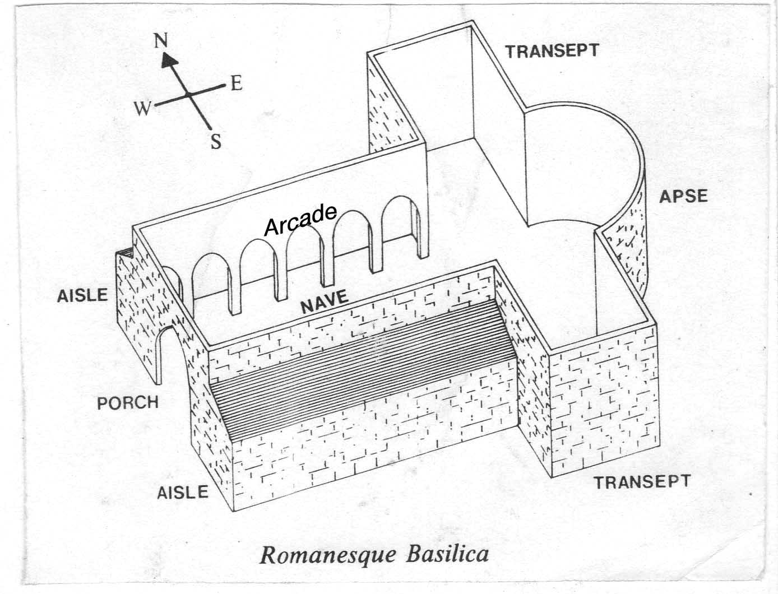
Gothic (G) or Romanesque (R)
6)
Why did you guess what you guessed?

Slide 8
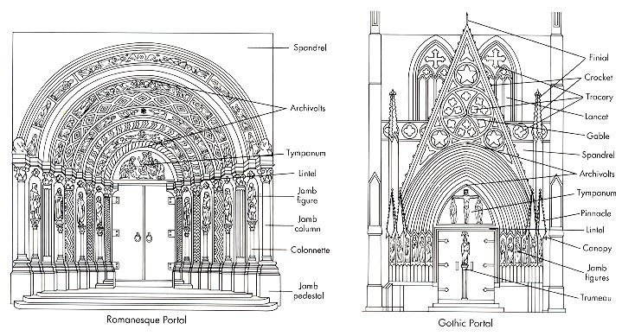
Video on Romanesque and Gothic Architecture
Gothic Vs Romanesque

Slide 9
Now let’s take the quiz again, knowing what you know. See if you can get them all correct.

Slide 10
1)
Gothic (G) or Romanesque (R)
Did your answer or reason for it change?

Slide 11
Gothic (G) or Romanesque (R)
2)
Did your answer or reason for it change?

Slide 12
Gothic (G) or Romanesque (R)
3)
Did your answer or reason for it change?

Slide 13
Gothic (G) or Romanesque (R)
4)
Did your answer or reason for it change?

Slide 14
Gothic (G) or Romanesque (R)
5)
Did your answer or reason for it change?

Slide 15
Gothic (G) or Romanesque (R)
6)
Did your answer or reason for it change?

Slide 16
How did you do?
What do we now know about these two types of architecture?
Romanesque
Gothic

